Slide 1
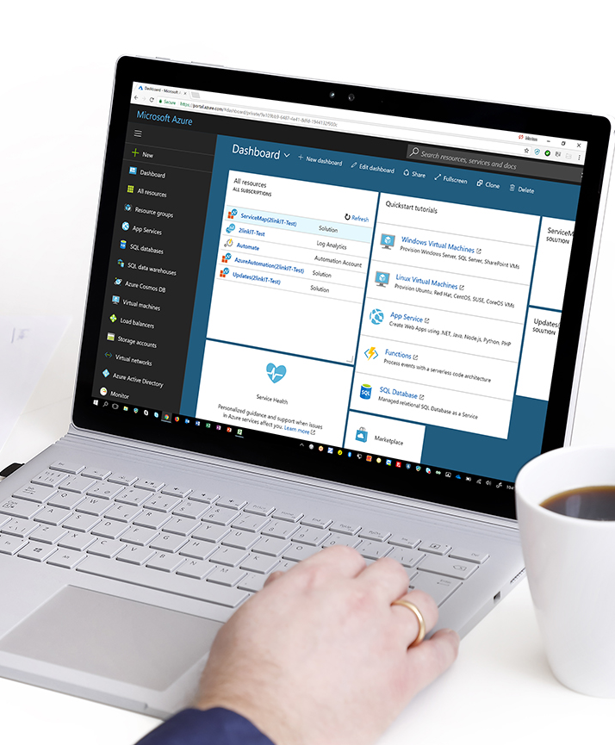


Are You in Control ? Gaining Deep Insight to your Infrastructure & Security using Advanced Azure Log Capabilities
Morten Knudsen

Slide 2
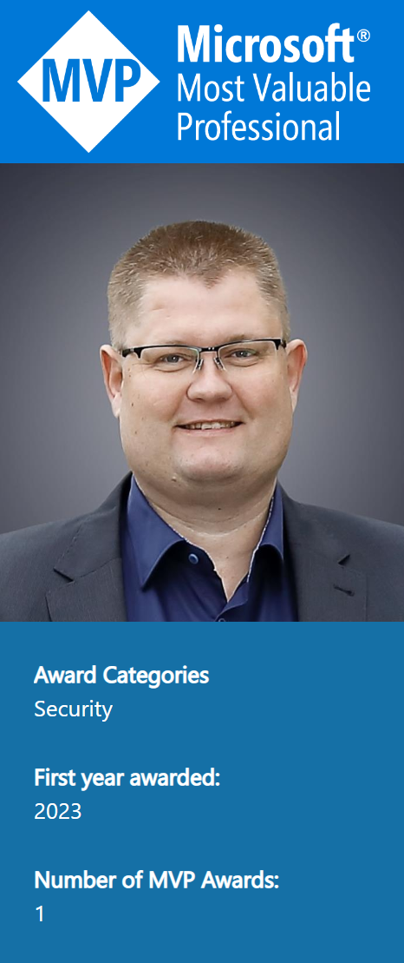
Speaker – Morten Knudsen
Cloud & Security Architect, blogger on mortenknudsen.net and speaking at events. Top-contributor in Cloud Security Customer Connection Program and Microsoft 365 Defender Customer Connection Program
Highly experienced Azure & Microsoft 365 Security specialist, who have been been in the IT-industry since 1991 working with Microsoft-technologies since 1994.
I work as a freelance consultant with focus on Azure, Microsoft 365 cloud and security technologies. My roles are primarily technical advisory, design and implementation for customers, but secondly, I am also helping my customers with the needed processes and getting their management and it-organization to support and adopt cloud – including operating model, cost management, reporting and governance.
My areas of technical specialization are Azure infrastructure, Microsoft Defender platform, Microsoft Sentinel, Microsoft LogAnalytics, Microsoft Workbooks, Azure Arc, Azure Resource Graph, Azure Extensions, Azure Monitor and scripting.

Slide 3

Session
This is NOT a product session – but inspiration on how you can use the Microsoft technologies to build your own cool log integrations to work with facts – for a little cost, compared to value
You will (hopefully) learn new stuff about how to use logging in a new way – and hear about technologies like Azure Log Ingestion Pipeline, Log Ingestion API and Azure Data Collection Rules
You will be the first to get a sneak-peak of a brand-new Powershell module, which Microsoft and I will be launching together in April
You will also get free access to cool showcase, ClientInspector – ready-to-use ☺

Slide 4
Showcase: Good Security demands to be and stay in control with the fundamentals !
Data Source
Information | Data Collection
Pending Windows Updates
Window firewall settings
Desired State Dashboards (KPIs)
Computers with wrong/missing Bitlocker config
Computers with pending updates released more than 40 days ago
Unexpected shutdowns during last 24 hours
Registry
Files
Bitlocker config
WMI
Powershell cmdlets – get-mppreference
Integration HR system
..
Members Local Admins
Hardware Serial Number
OS Last Restart
..
Incomplete Office update channel
Incompliant Real Protection antivirus
Computer not refreshing Group Policies during last 7 days
Security-portal (Advanced Hunting)- REST API
Logfiles
SQL performance counters
..
Technologies:
ClientInspector
(REST API endpoint)
AzLogDcrIngestPs PS module
Azure Log Ingestion Pipeline
Azure Data Collection Rules
Azure Data Collection Endpoints
Azure Workbooks
Azure Dashboards
Microsoft Sentinel

Slide 5
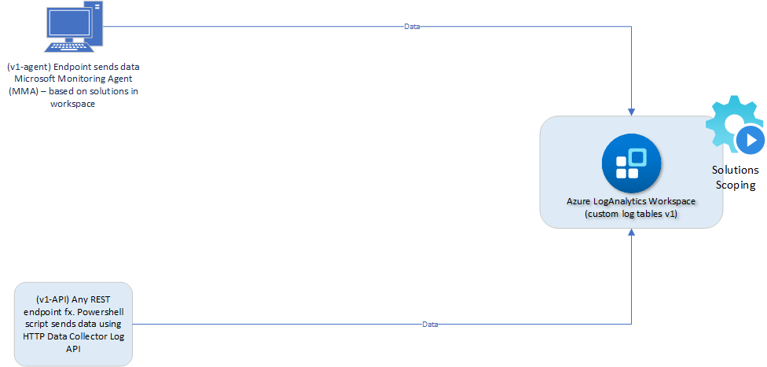
Legacy method

Slide 6
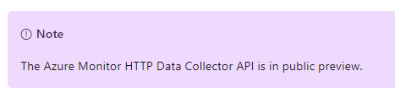
Confused – hmmm ???
How can ”the legacy method” still be in public preview?
Response from product team
“Data Collector API was never officially released or considered “complete”
We are going to update Data Collector API documentation as part of its deprecation cycle”

Slide 7
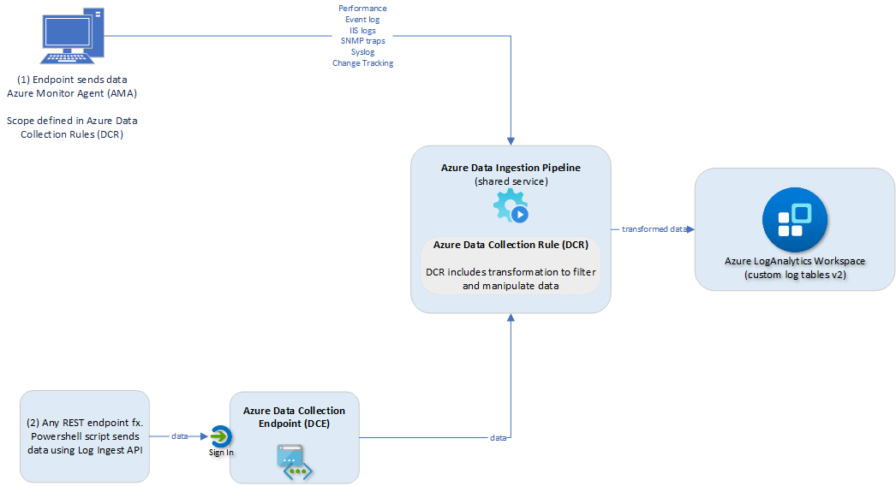
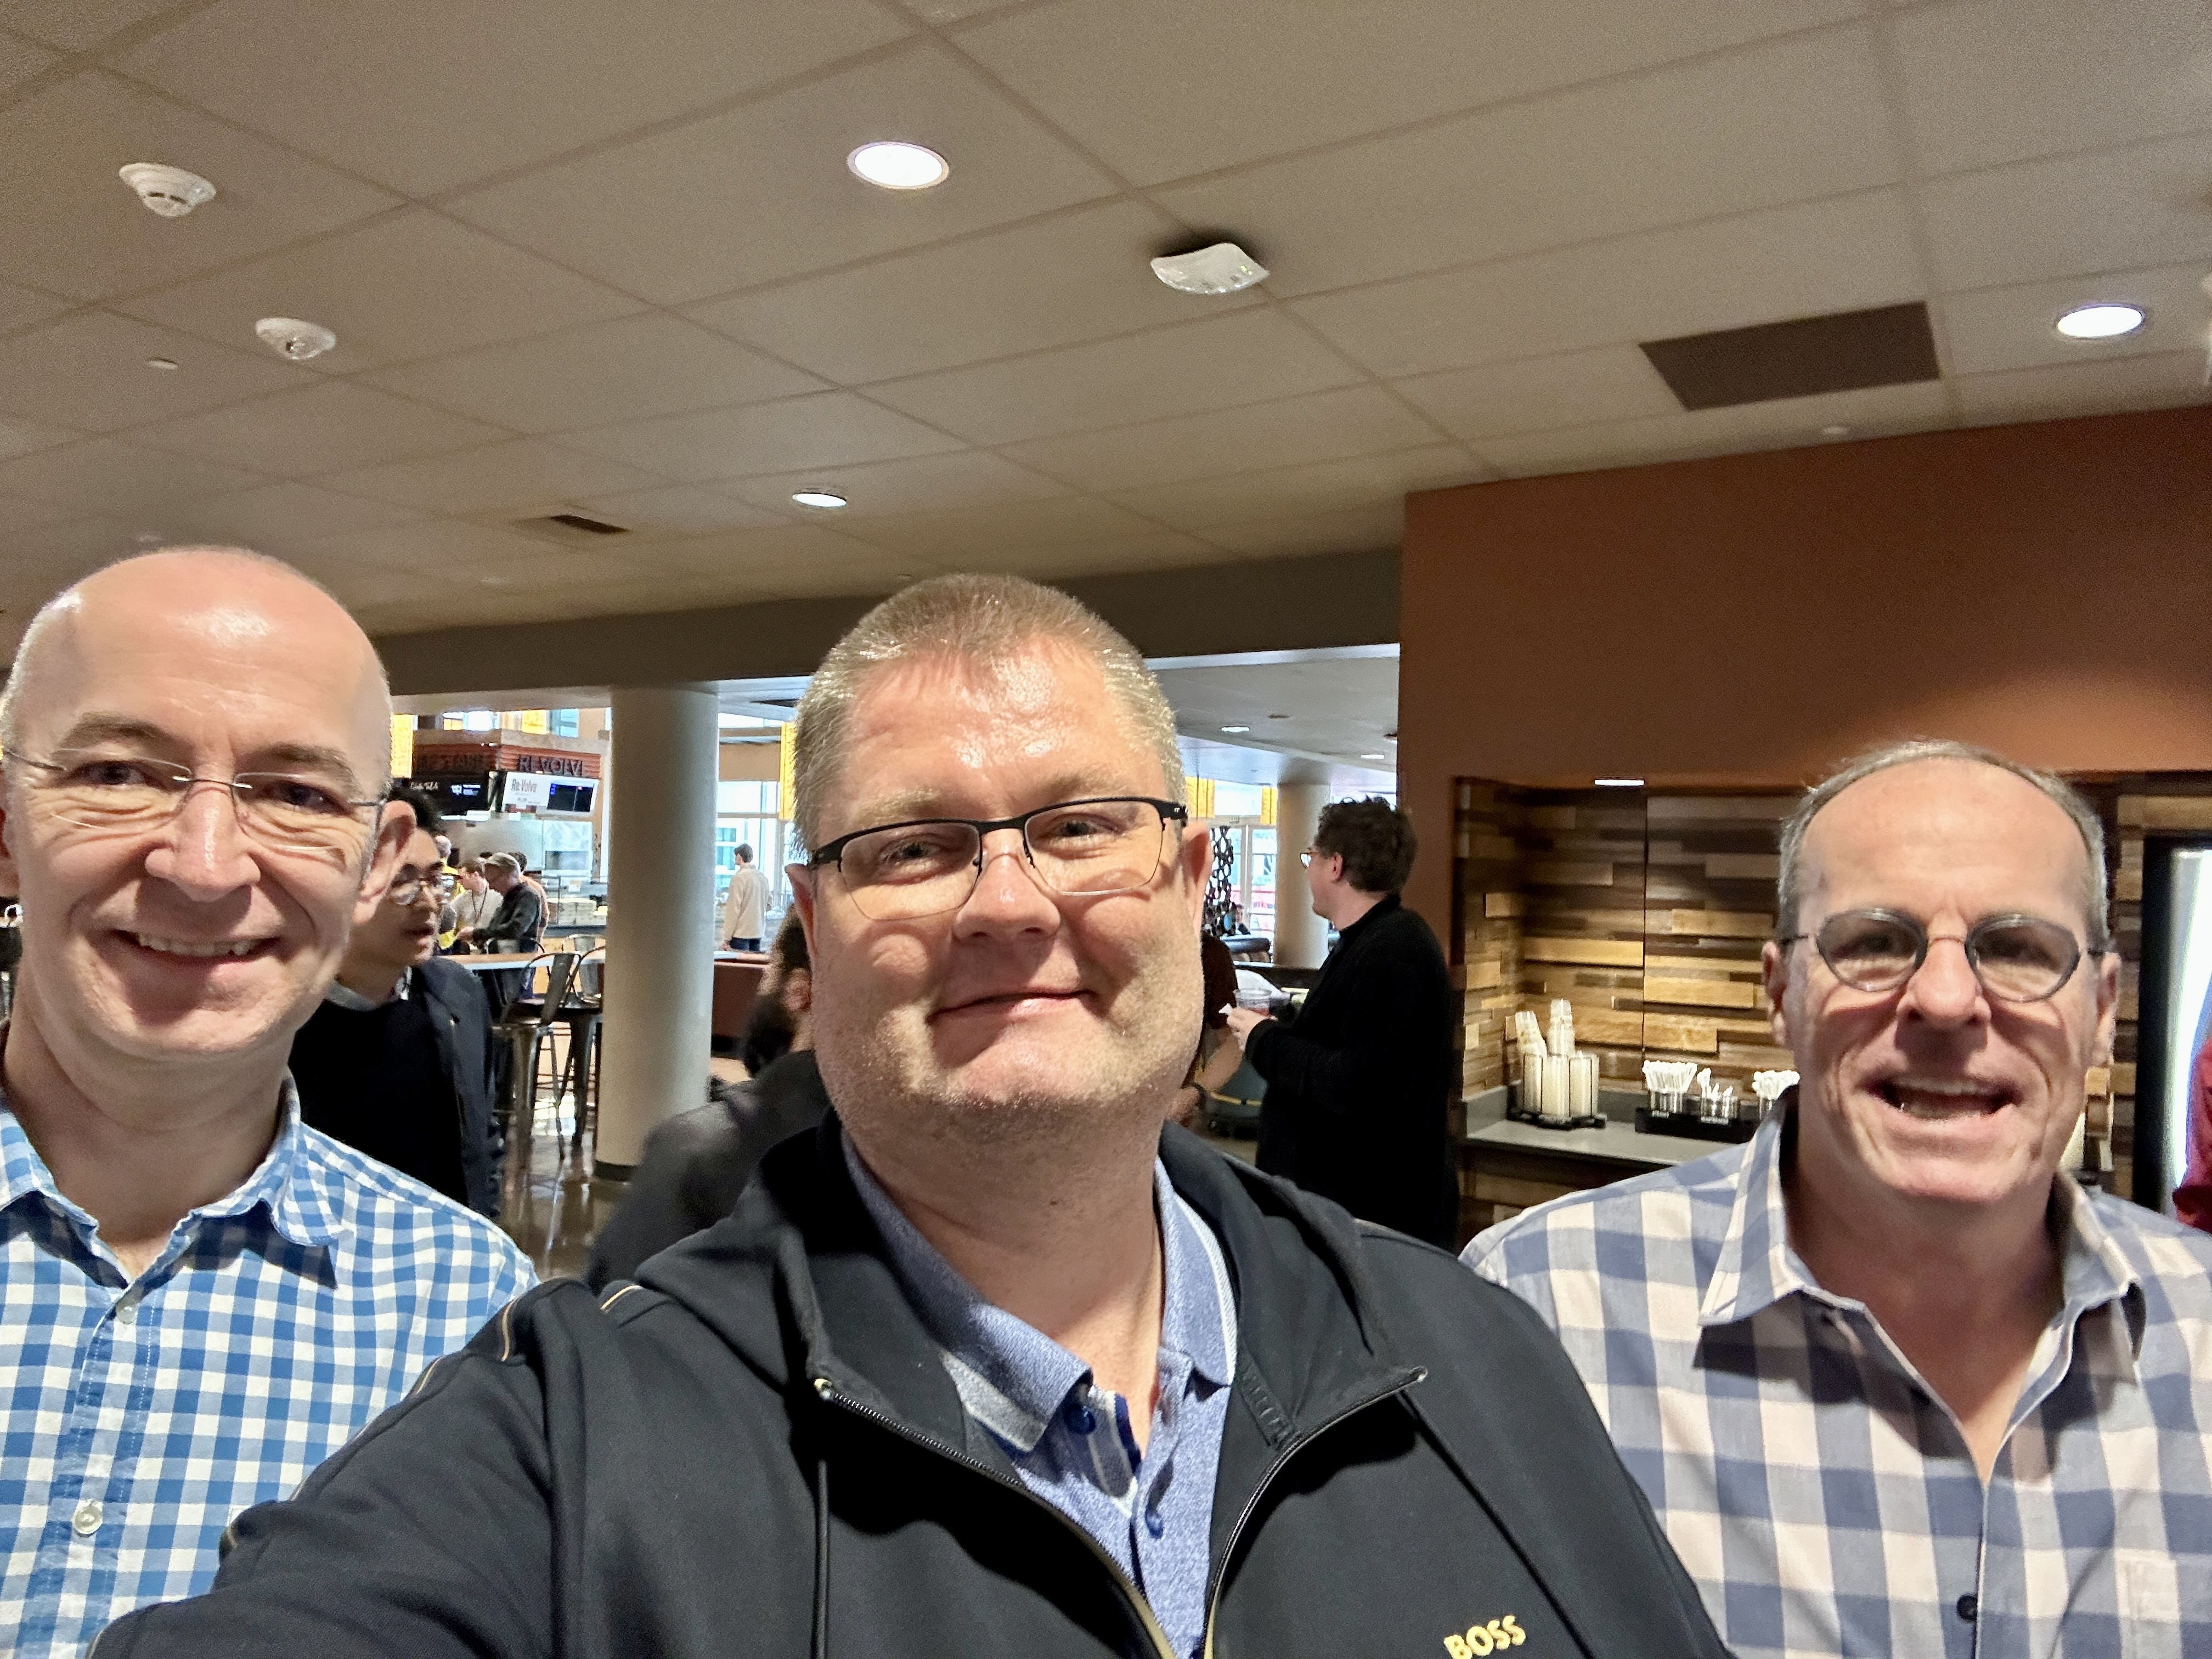
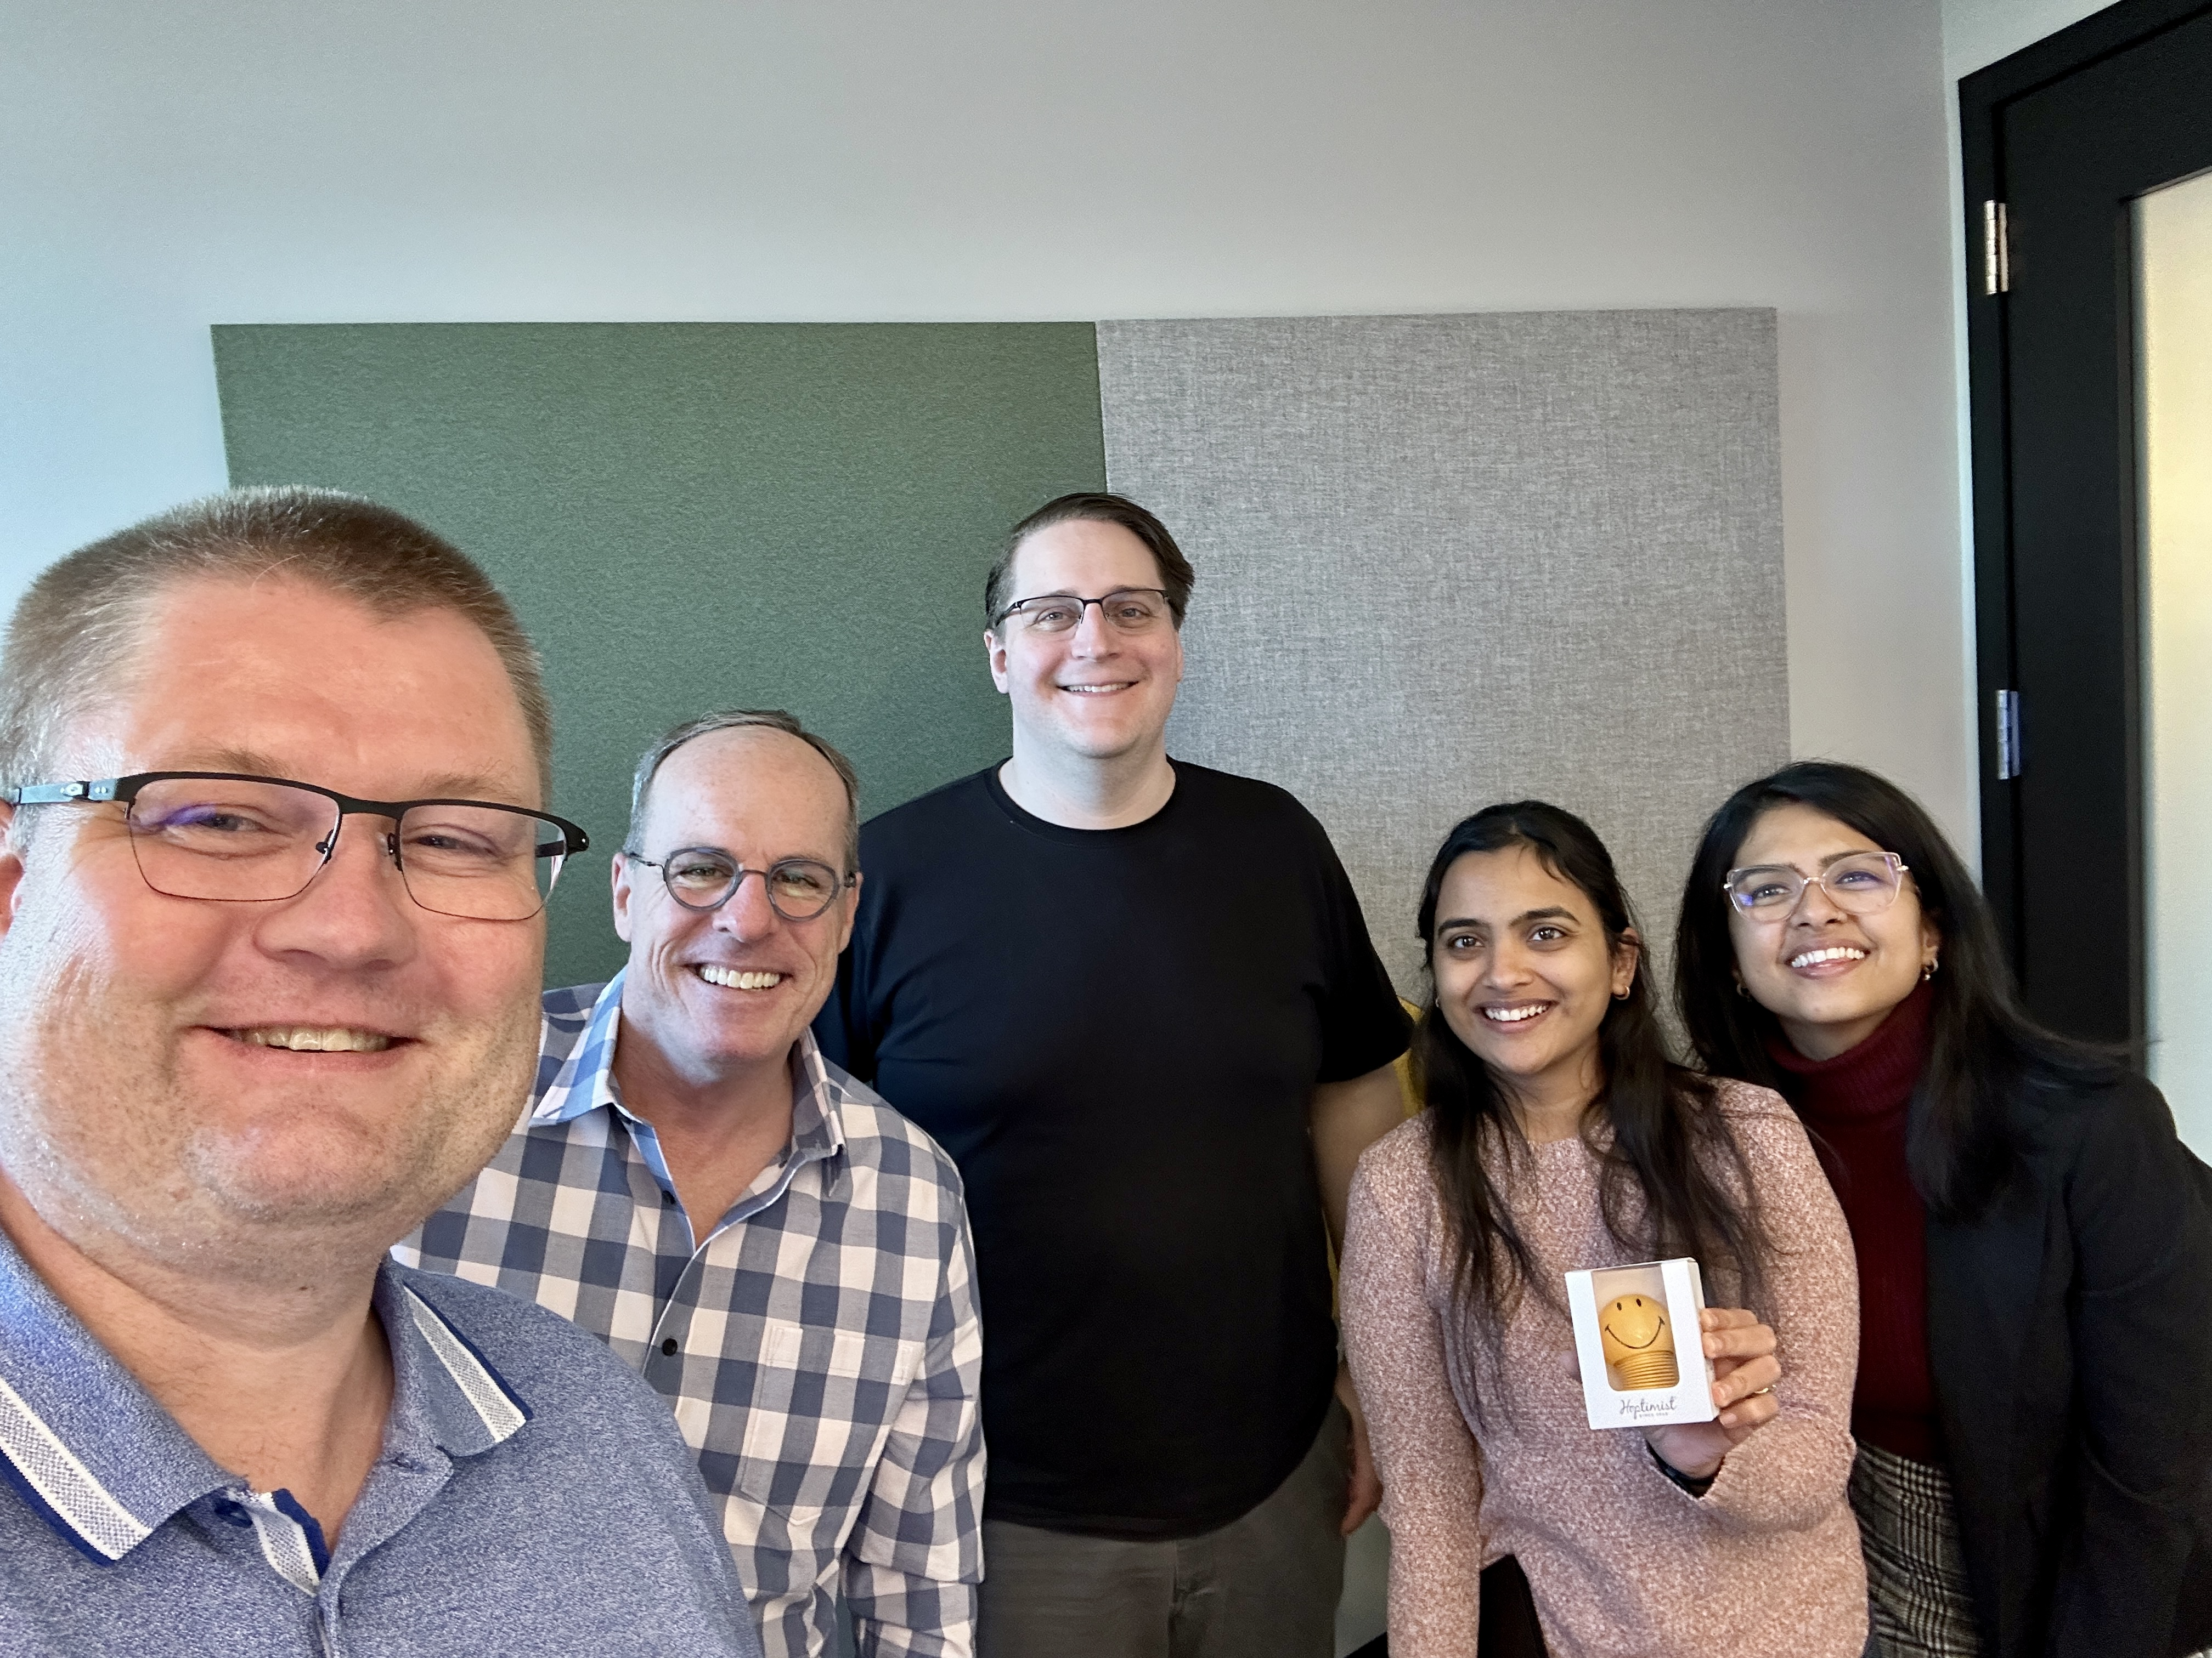
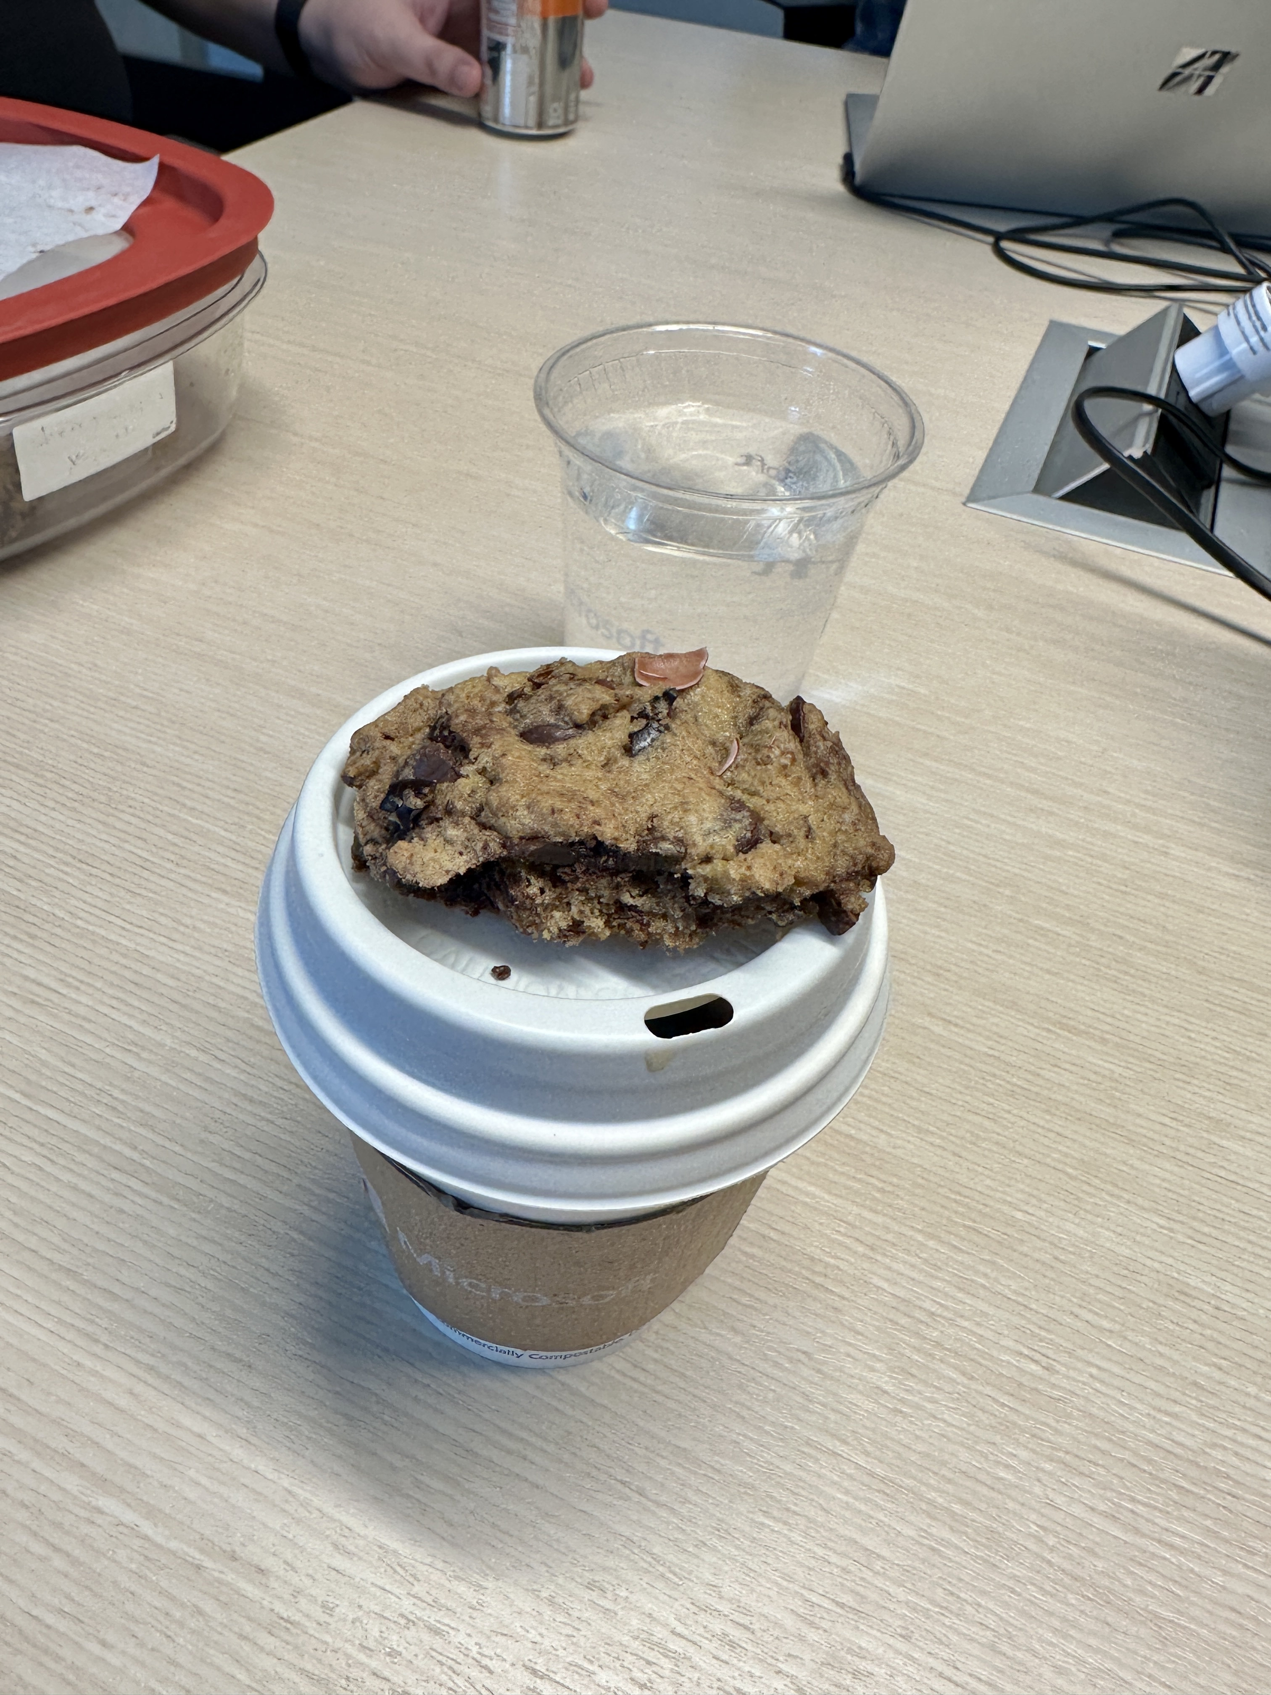
New method

Slide 8
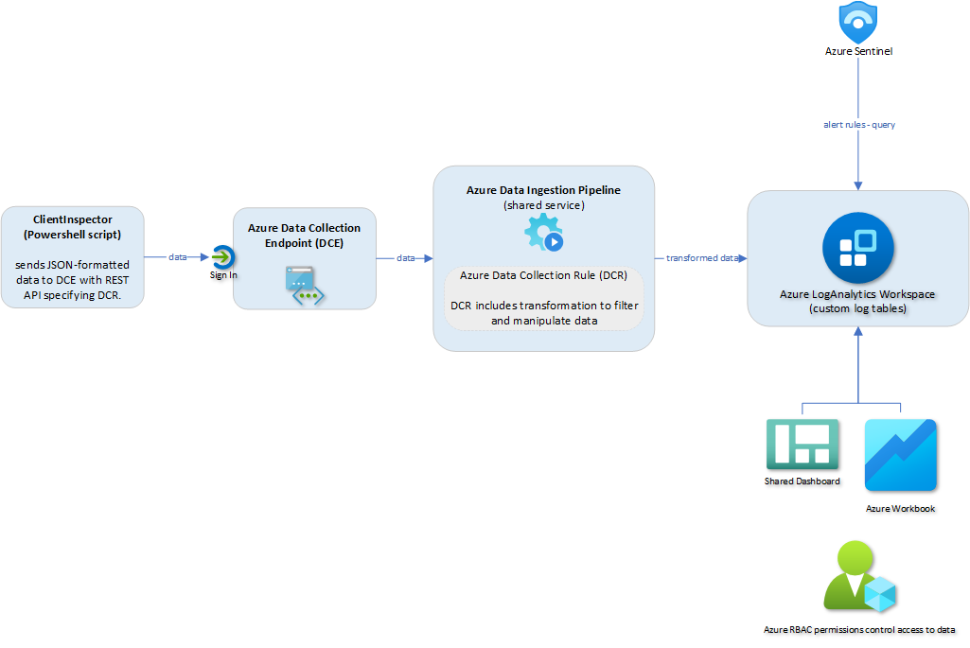
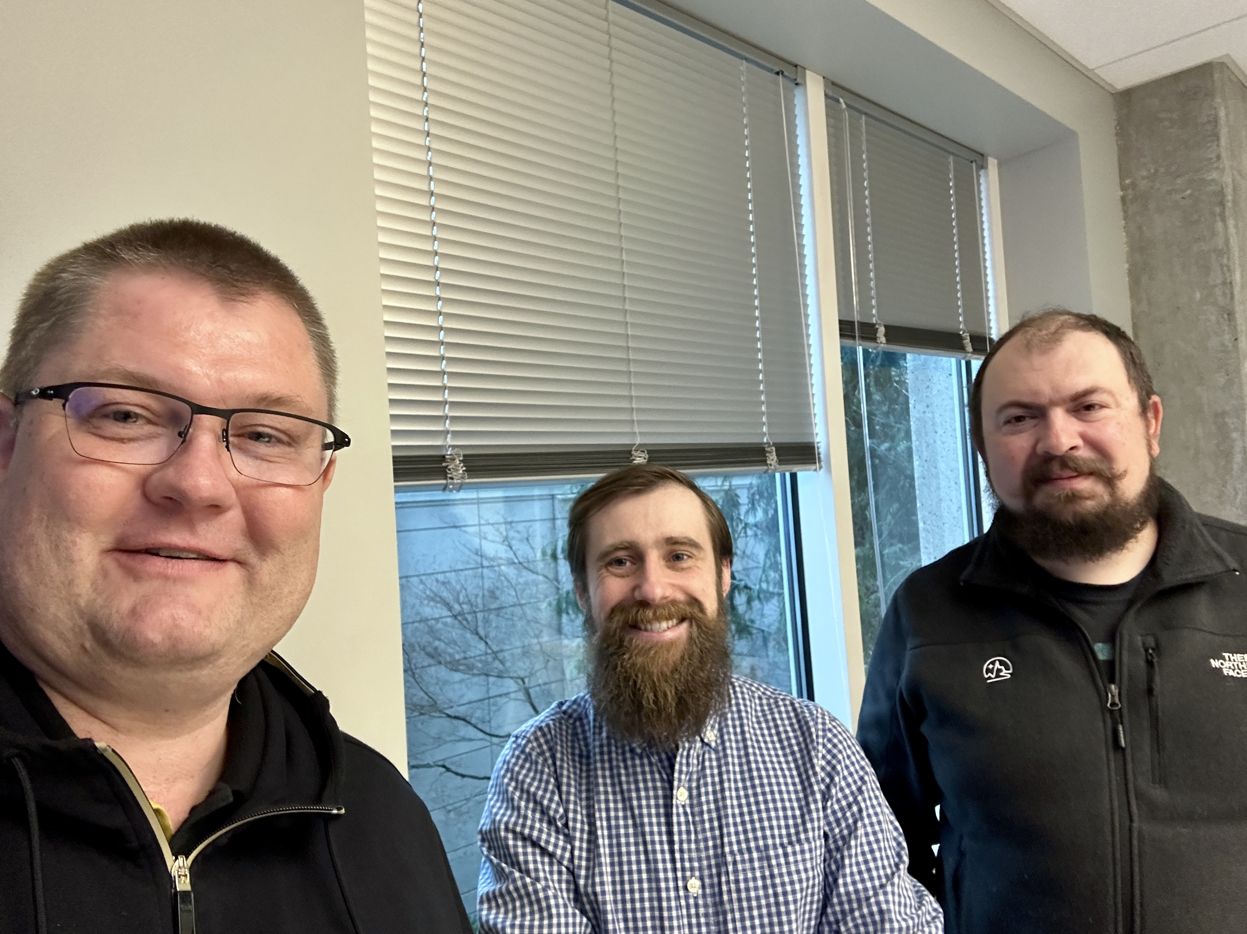
Azure Pipeline “magicians”
Meet Ivan & Evgeny,
Azure Data Ingestion Pipeline PMs

Slide 9
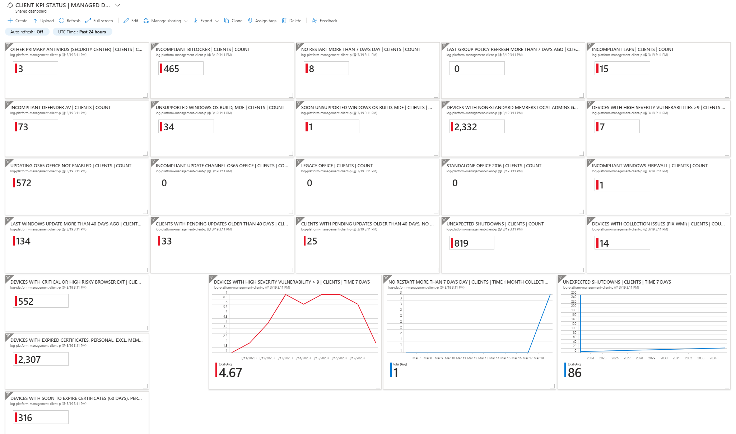

Slide 10
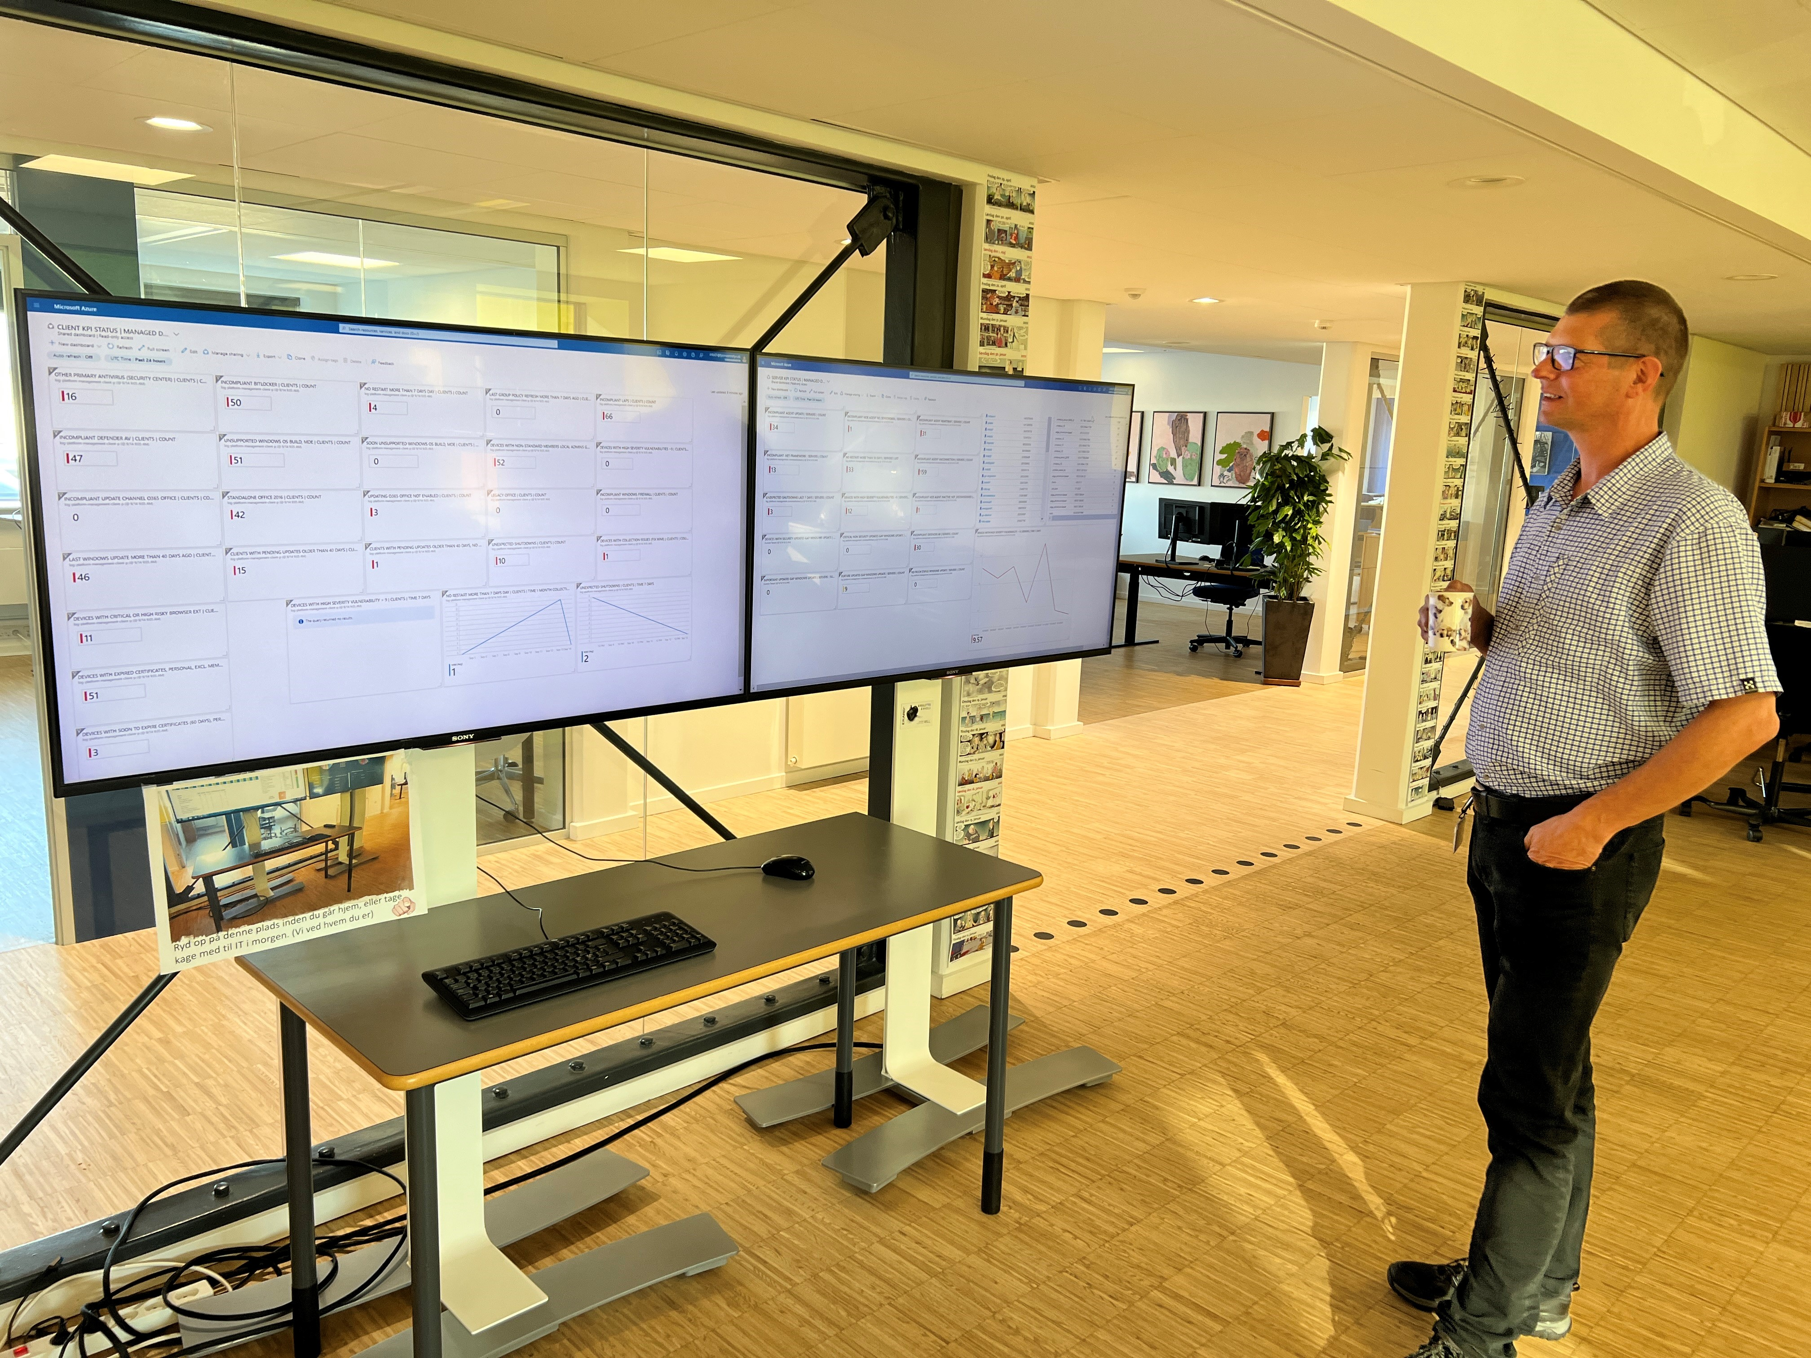

Slide 11
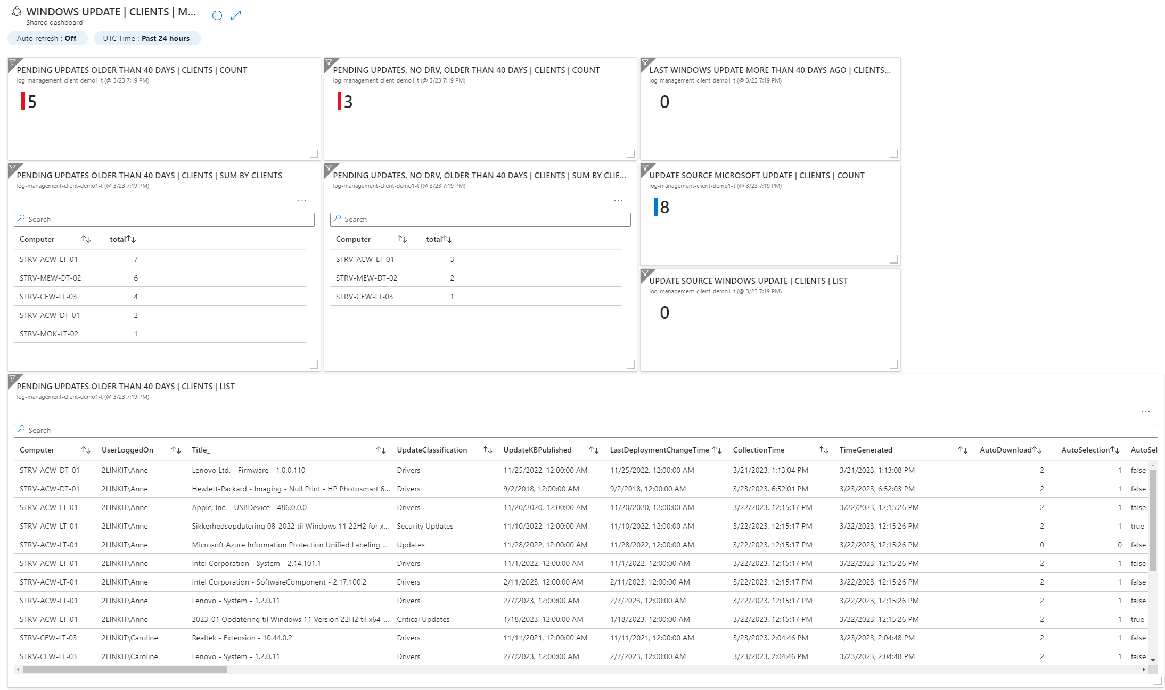

Slide 12
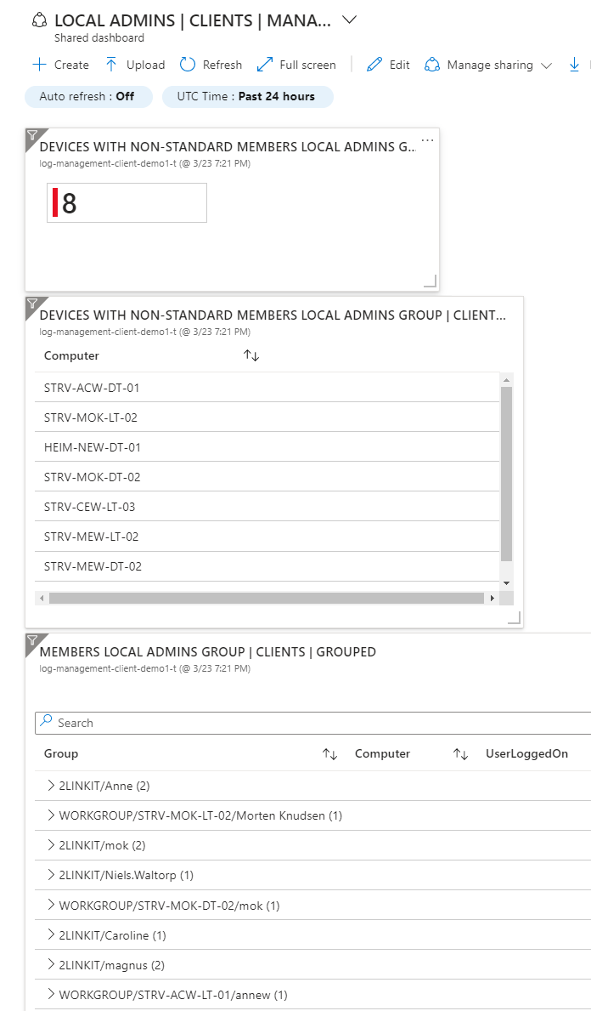

Slide 13
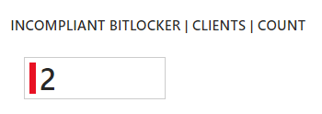
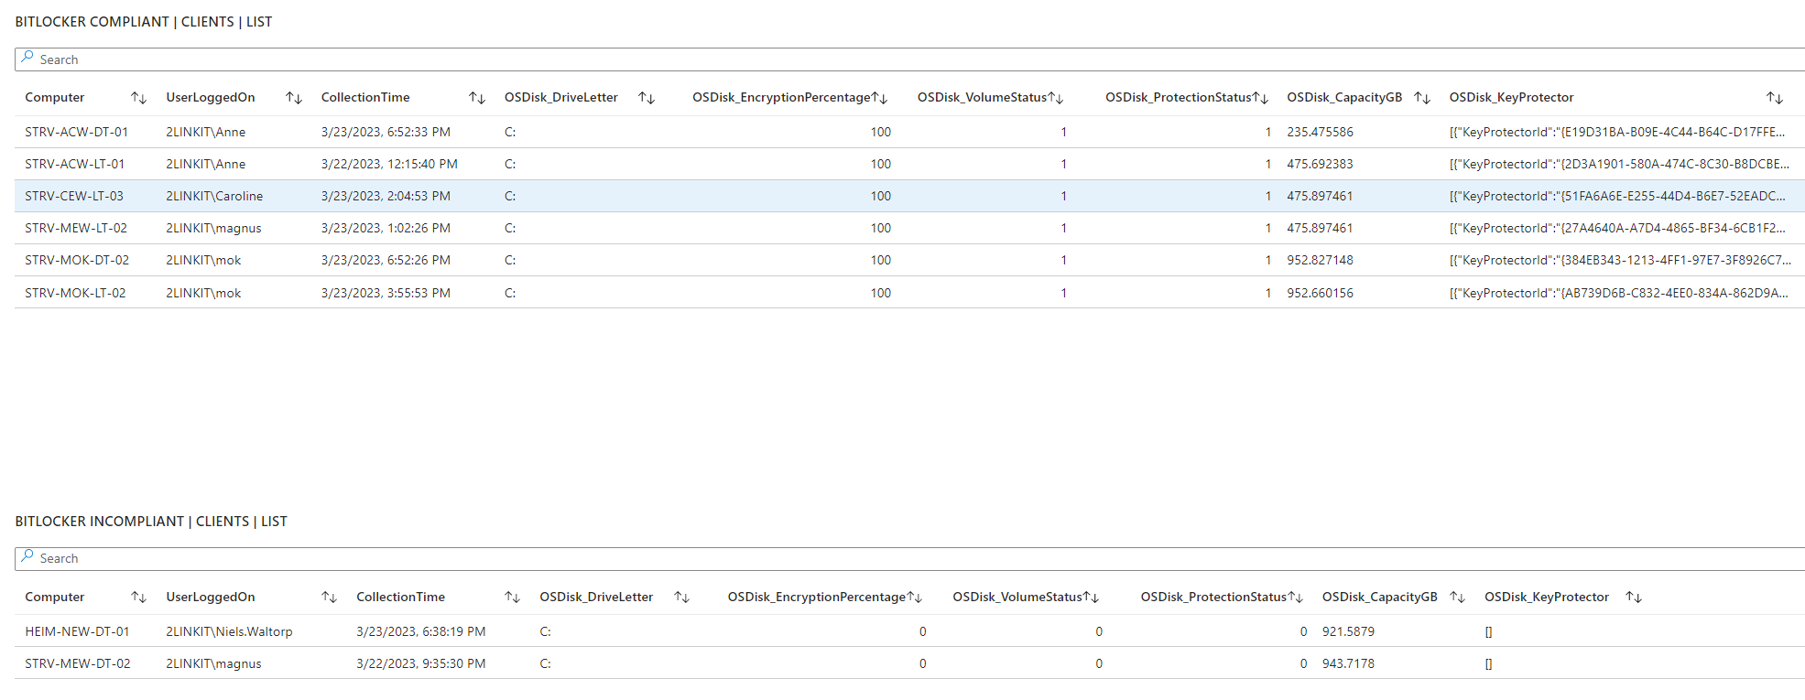

Slide 14
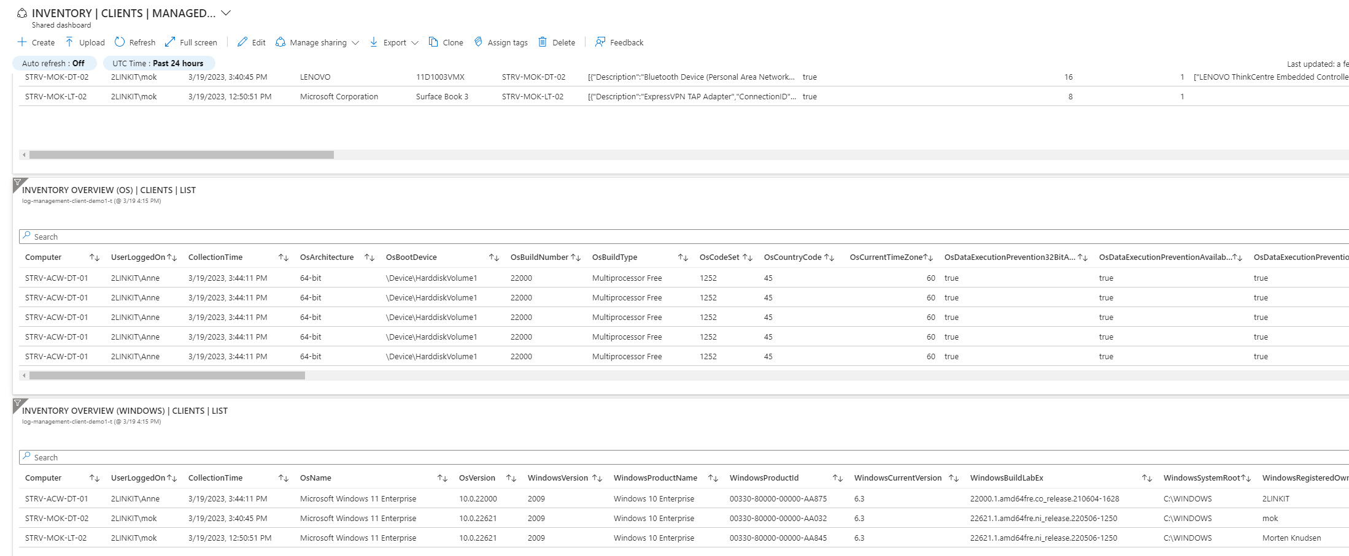

Slide 15
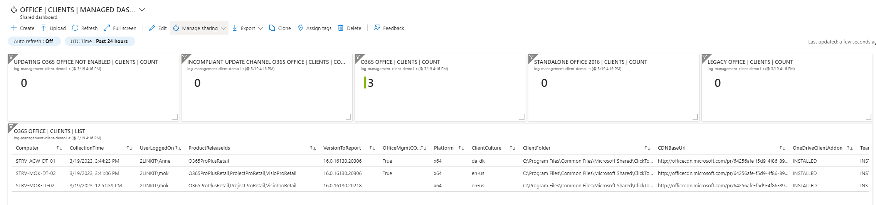
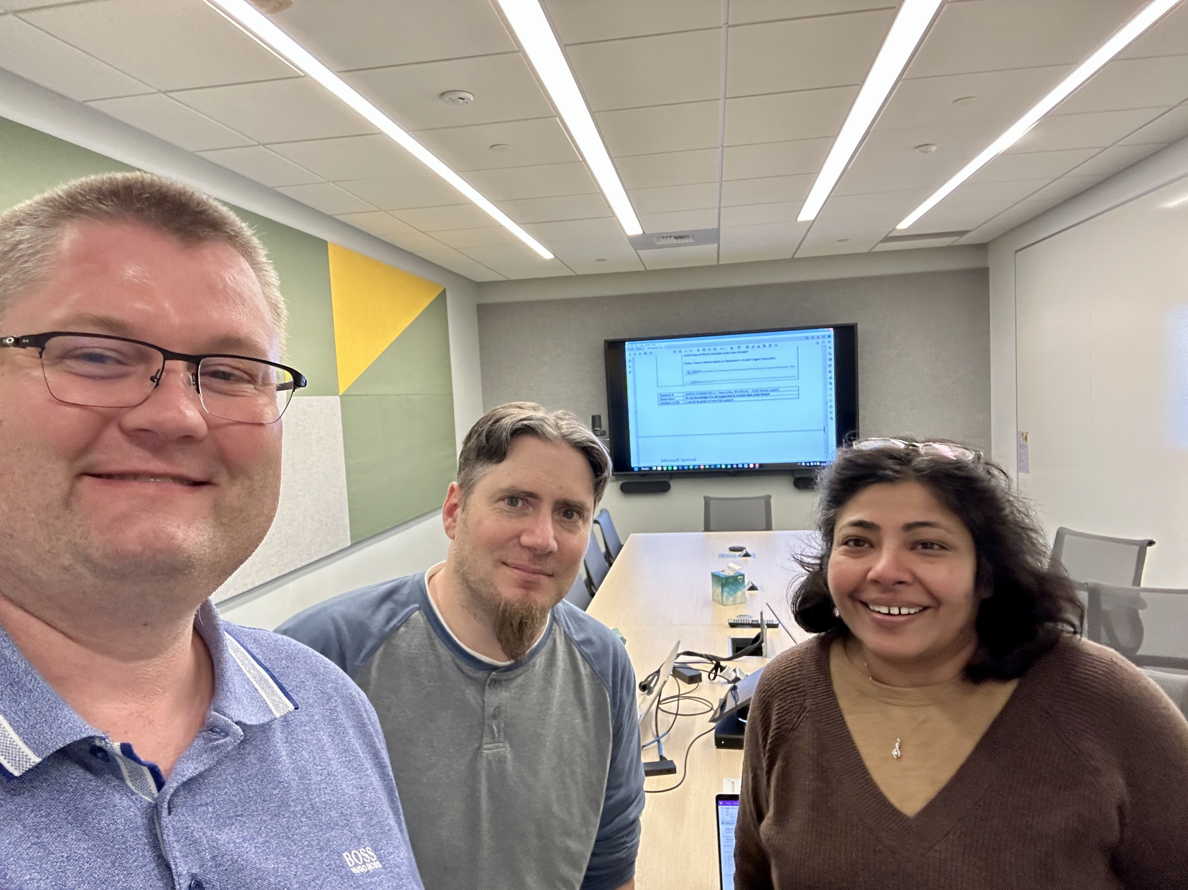
Meet the people in charge of Azure Workbooks & Azure Dashboards
– John & Shikha

Slide 16
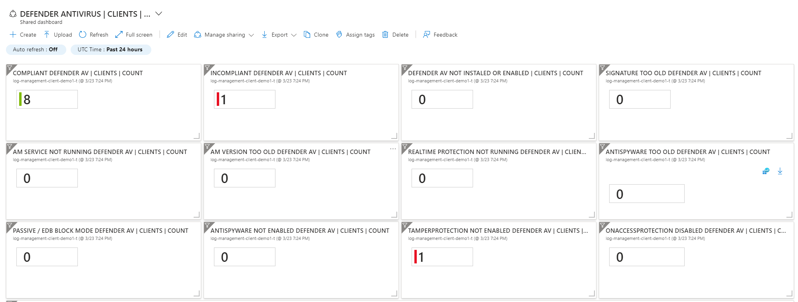

Slide 17
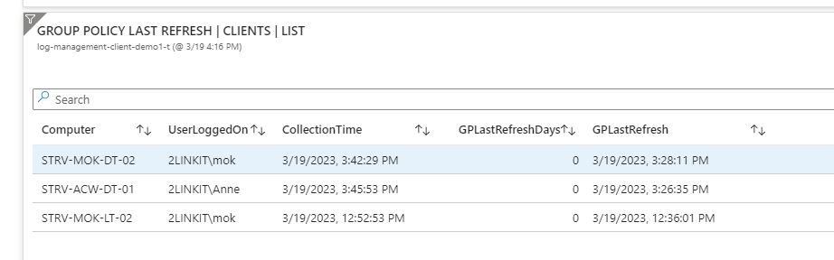
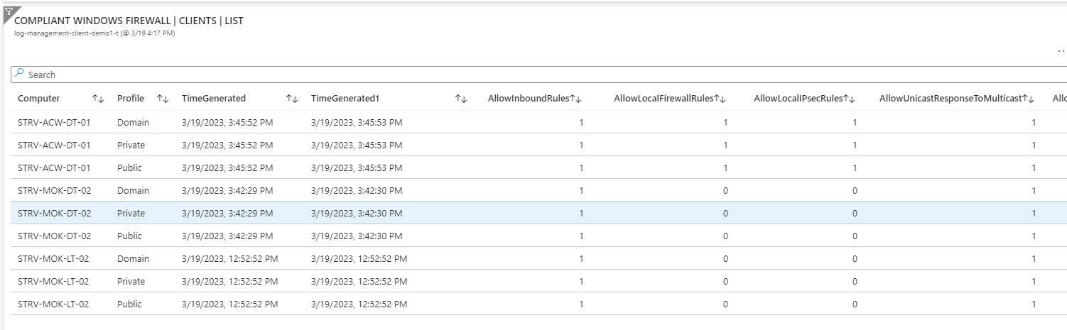

Slide 18
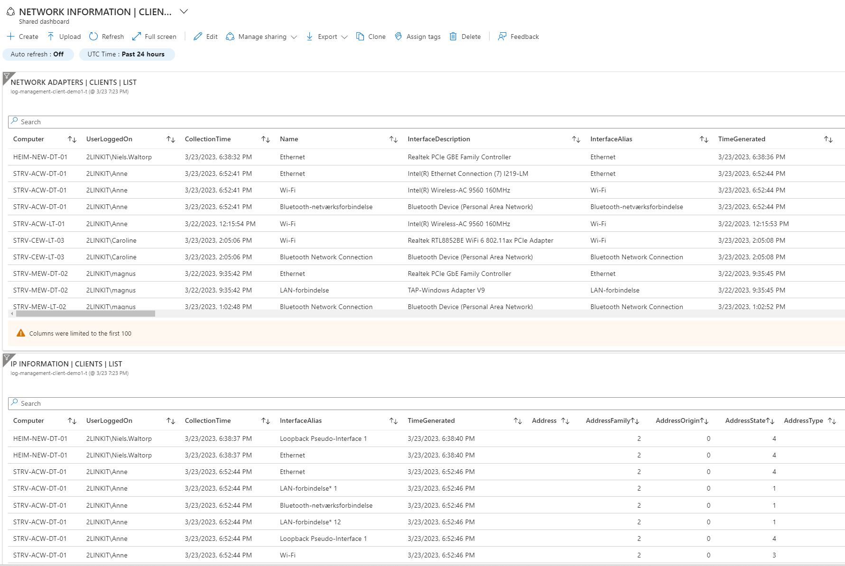

Slide 19
Sample use cases – let the creativity loose ☺
Detect local printers – replace with large multi-function printers (prepare business case)
PC replacement – yearly budget (sample next slide) – Lenovo / Dell warranty
Cisco SecureX integration (REST API) – get alerts over
Cisco Prime (REST API) – wifi connectivity – which APs + SSID are users connecting to
SQL monitoring

Slide 20

Warranty lookup Lenovo – via collected data (online)

Slide 21
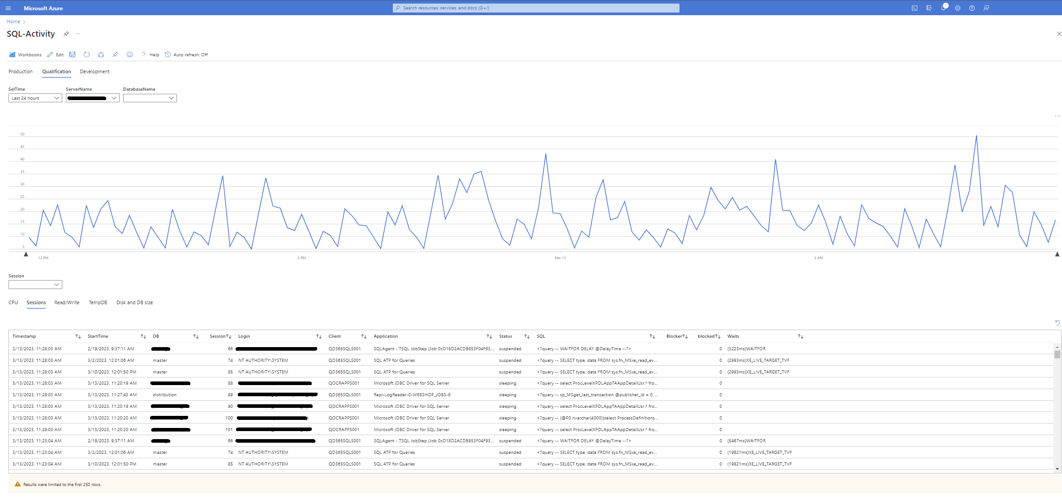
SQL Monitoring

Slide 22


Slide 23
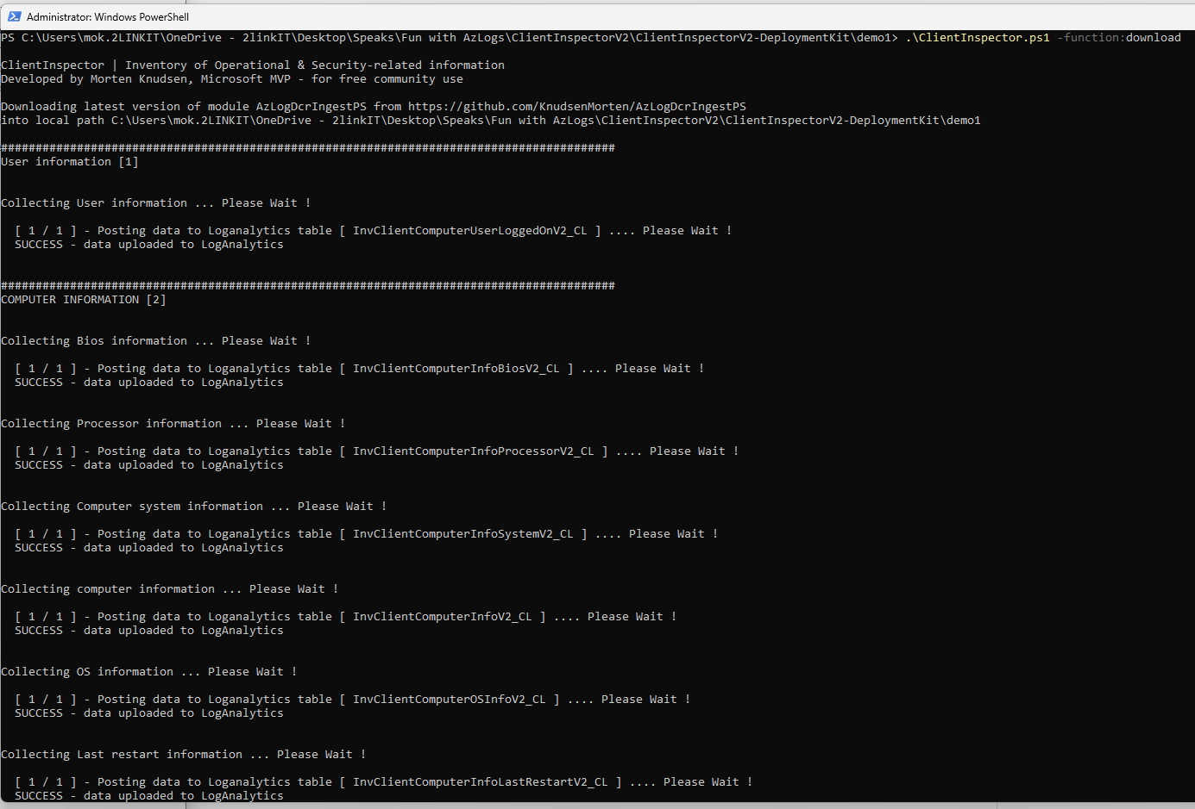
Run with
ConfigMgr
Intune
any deployment-tool
Servers:
RemotePS
CustomScript Extension
Server inventory of 114 servers in 2 min - using Azure Custom Extension

Slide 24
Query

Slide 25
Dashboards

Slide 26
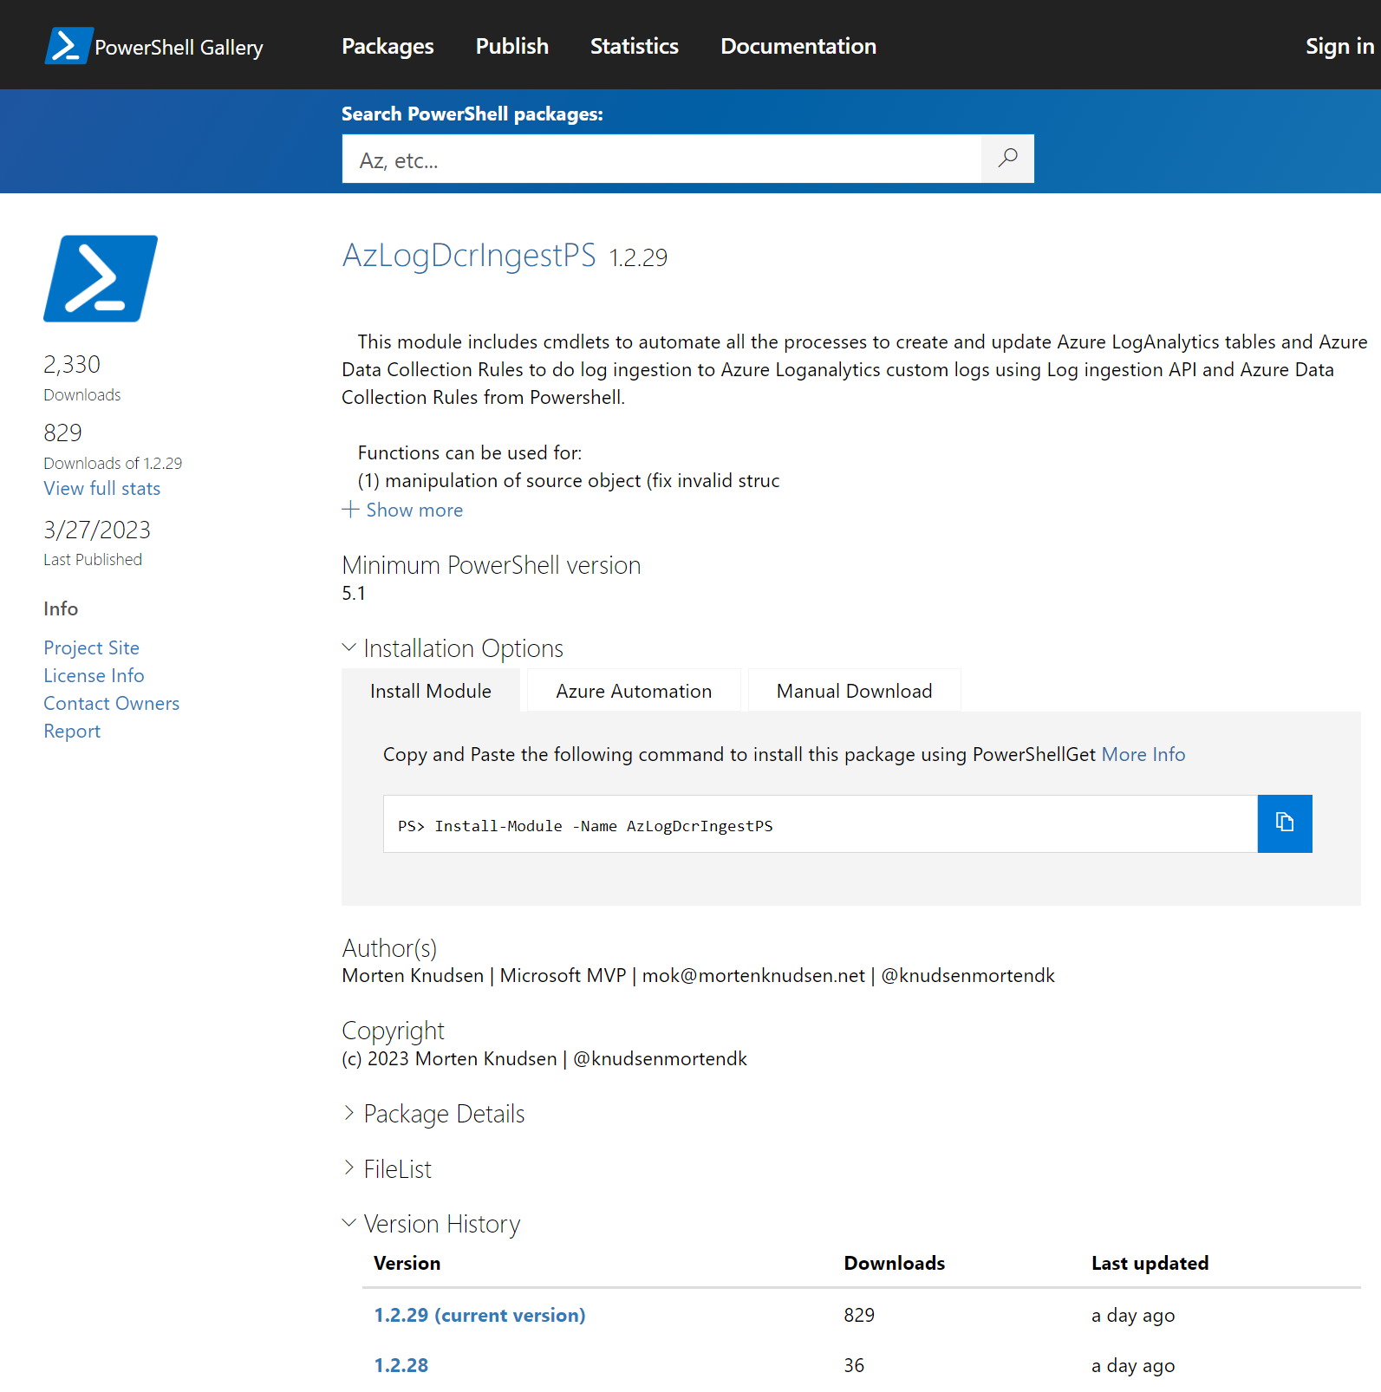
The little helper Powershell module – AzLogDcrIngestPS
Core features:
create/update the DCRs and tables automatically - based on the source object schema
validate the schema for naming convention issues. If exist found, it will mitigate the issues
update schema of DCRs and tables, if the structure of the source object changes
auto-fix if something goes wrong with a DCR or table
can remove data from the source object, if there are colums of data you don't want to send
can convert source objects based on CIM or PS objects into PSCustomObjects/array
can add relevant information to each record like UserLoggedOn, Computer, CollectionTime

Slide 27
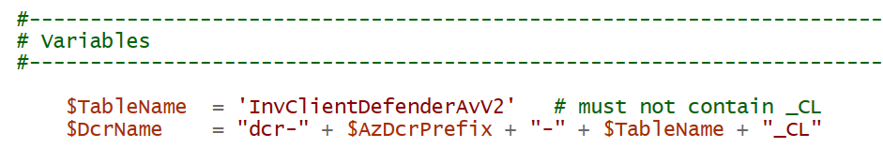
Variables (1/4) naming - where to send the data

Slide 28
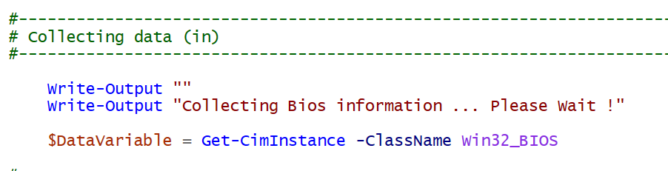
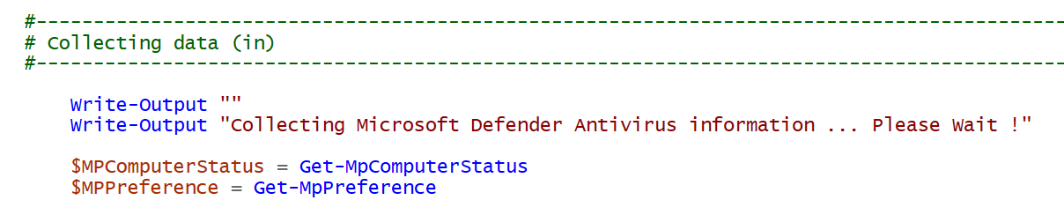
Data Collection (2/4)

Slide 29
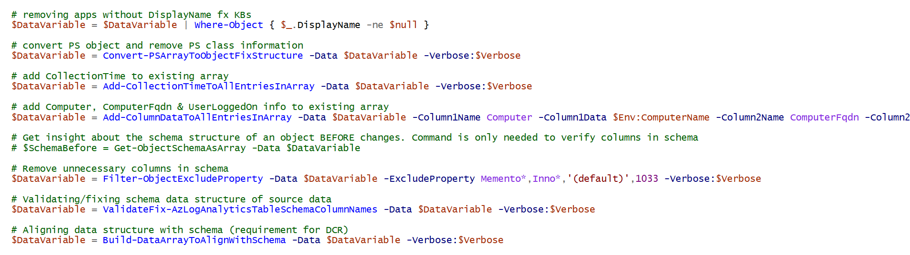
Data Manipulation (3/4) ensure data is in correct format and any "noice" was removed and relevant information has been added

Slide 31
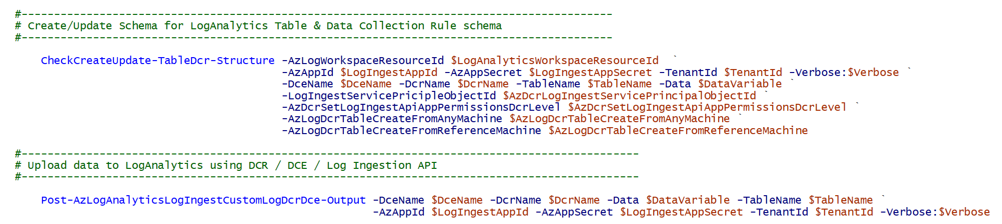
Data Out (4/4) send to LogAnalytics - combined functions

Slide 34
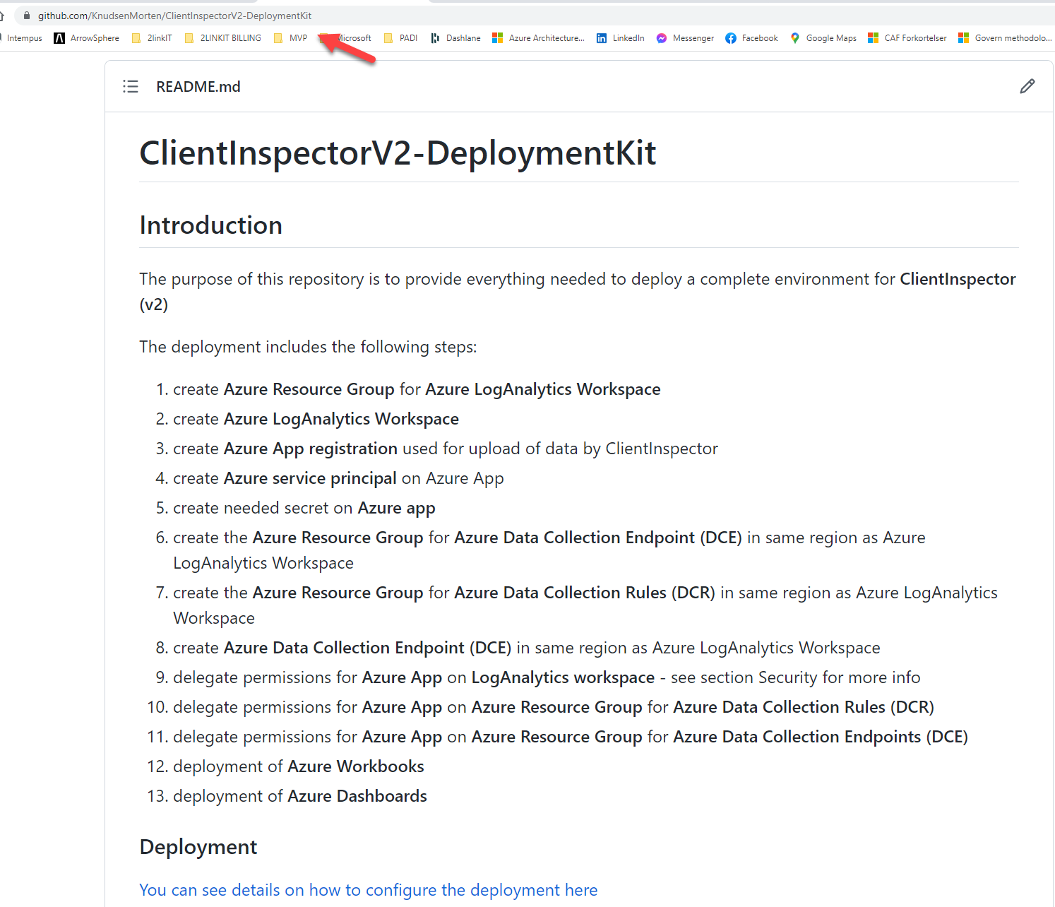
https://github.com/KnudsenMorten/ClientInspectorV2-DeploymentKit
You can get started today
for free (only pay for Azure consumption)

Slide 36
TAK for i dag ☺
Mail: mok@mortenknudsen.net | mok@2linkit.net
Blog: https://mortenknudsen.net/
Linkedin: https://www.linkedin.com/in/mortenwaltorpknudsen/
Github: https://github.com/KnudsenMorten
Twitter: https://twitter.com/knudsenmortendk
Topic | Link
ClientInspector | https://github.com/KnudsenMorten/ClientInspectorV2
ClientInspector DeploymentKit | https://github.com/KnudsenMorten/ClientInspectorV2-DeploymentKit
Powershell module AzLogDcrIngestPS | https://github.com/KnudsenMorten/AzLogDcrIngestPS
Deep-dive about Azure Data Collection Rules (DCRs) | https://github.com/KnudsenMorten/AzLogDcrIngestPS#deep-dive-about-azure-data-collection-rules-dcrs
Deep-dive about Log Ingestion API | https://github.com/KnudsenMorten/AzLogDcrIngestPS#deep-dive-about-log-ingestion-api

Slide 37
More deep-dive information, if people are interested (not part of main presentation)

Slide 38
What is collected ?
User Logged On to Client
Computer information
bios, processor, hardware info, Windows OS info, OS information, last restart
Installed applications
both using WMI and registry
Antivirus Security Center from Windows
default antivirus, state, configuration
Microsoft Defender Antivirus
all settings including ASR, exclusions, realtime protection, etc
Office - version, update channel config, SKUs
VPN client - version, product
LAPS – version
Admin By Request (3rd party) – version
Bitlocker - configuration
Windows Update
last result (when), windows update source information (where), pending updates, last installations (what)
Eventlog
look for specific events including logon events, blue screens, etc.
Network adapters - configuration, installed adapters
IP information for all adapters
Local administrators group membership
Windows firewall
settings for all 3 modes
Group Policy - last refresh
TPM information
relevant to detect machines with/without TPM

Slide 39
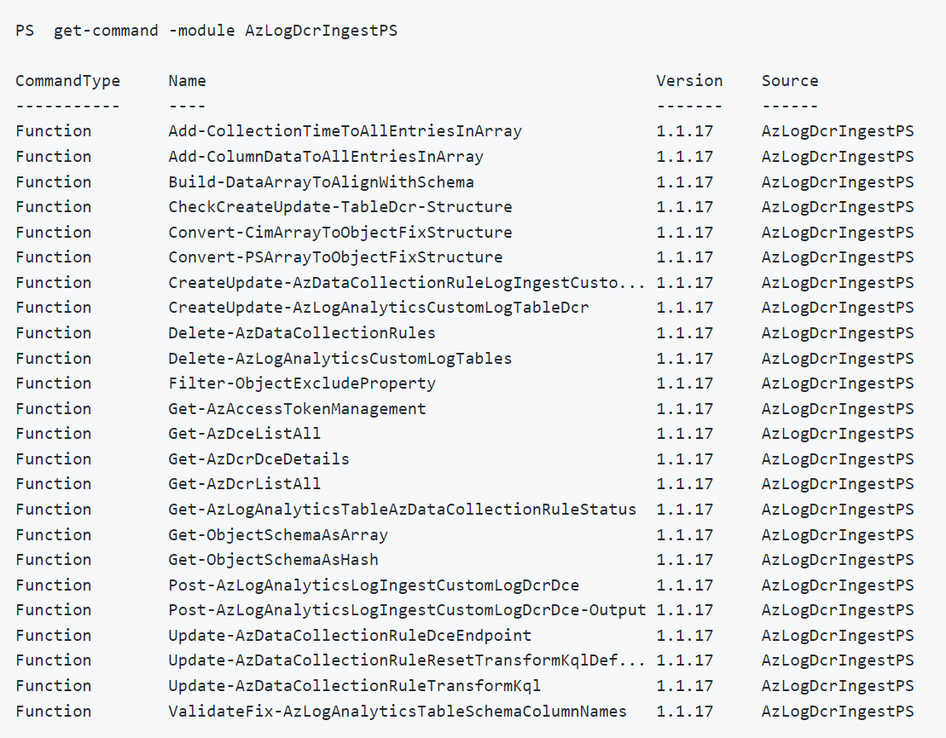
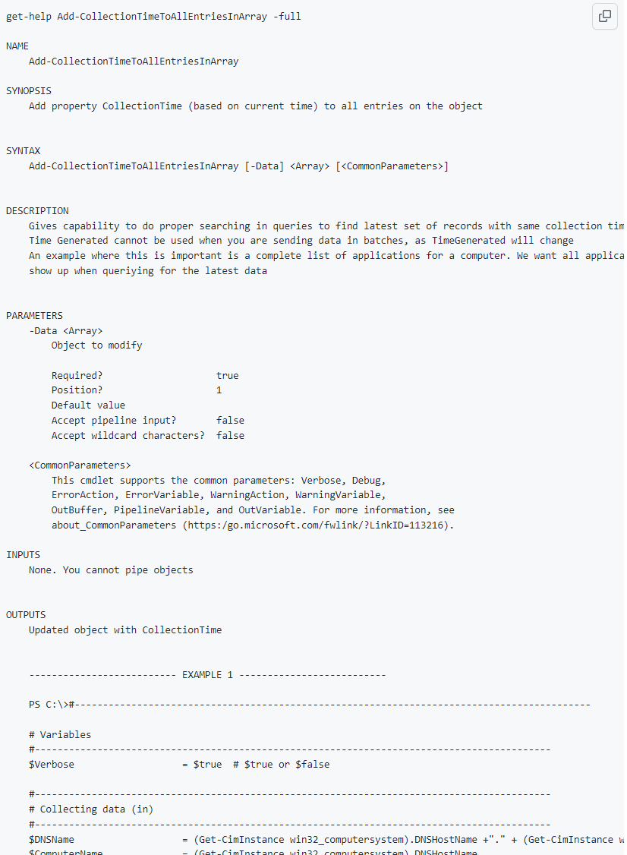

Slide 40
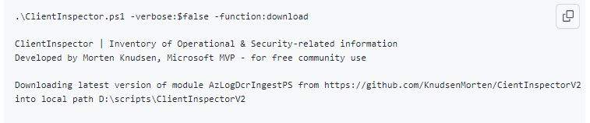
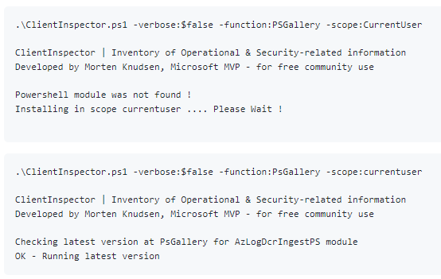
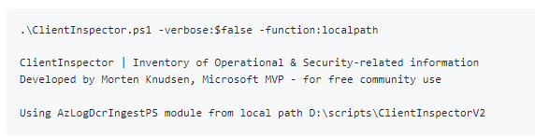

Slide 41
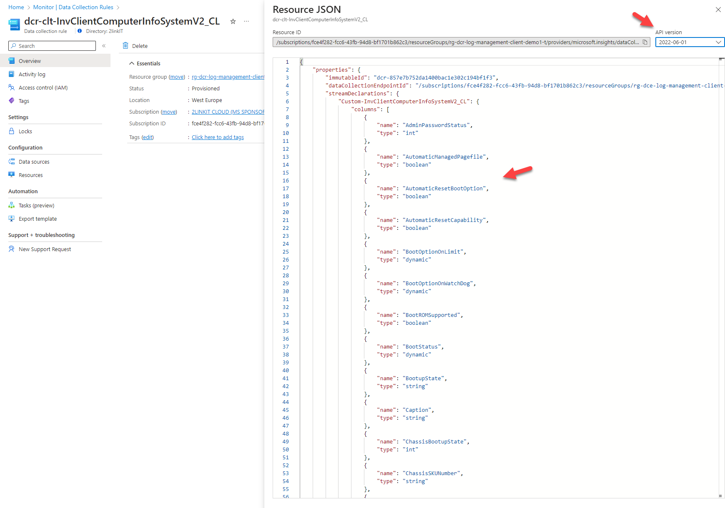
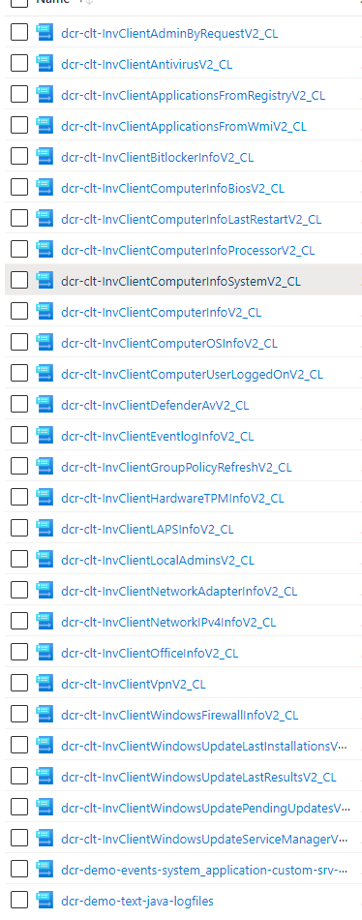

Slide 42
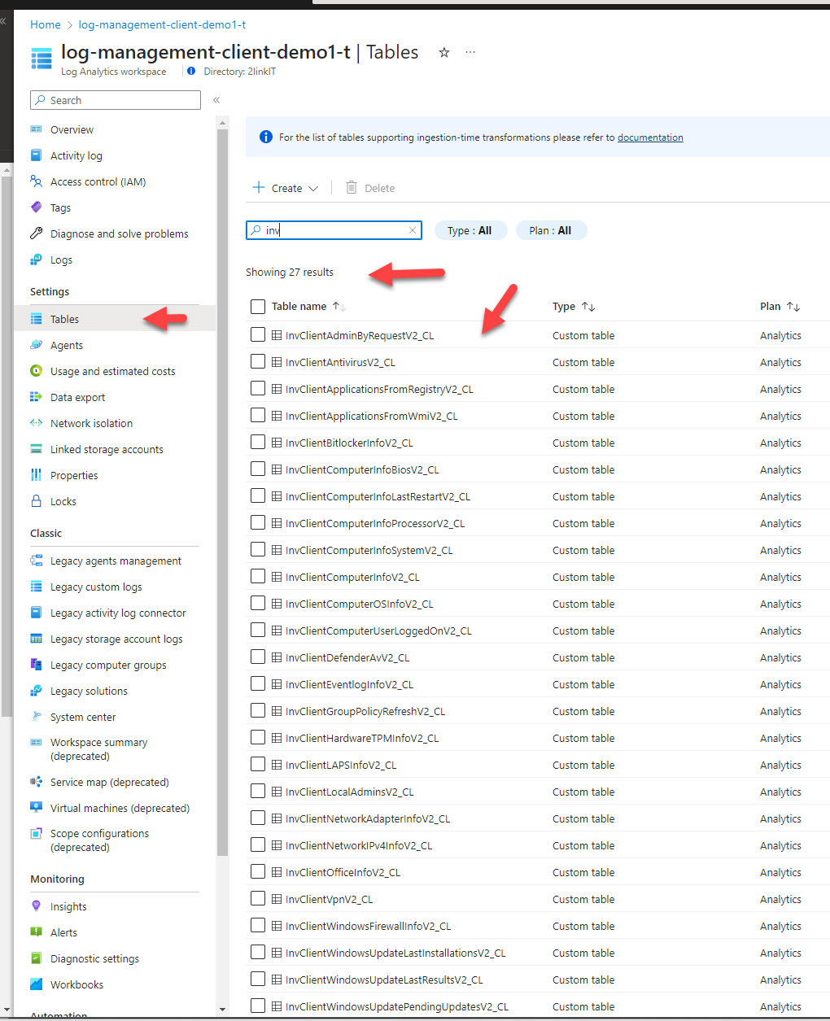
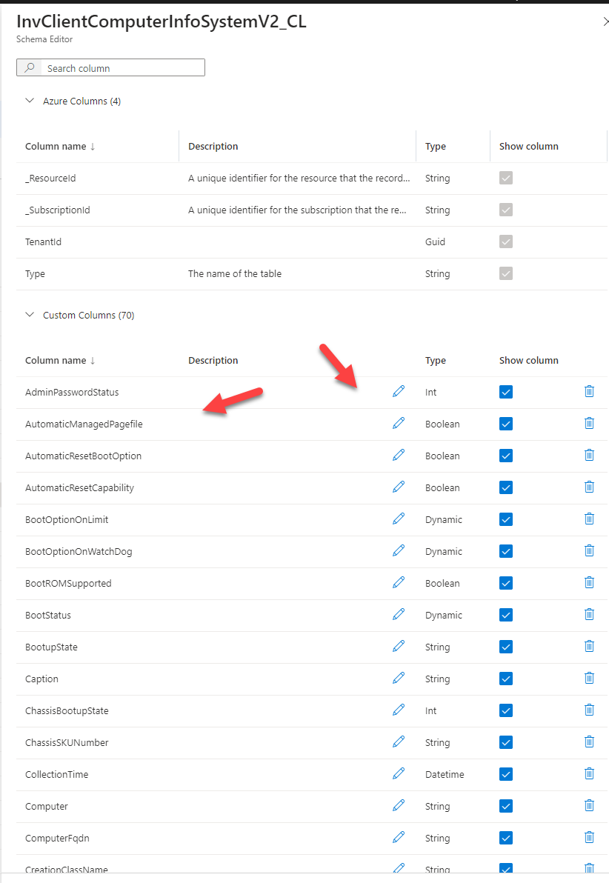

Slide 43
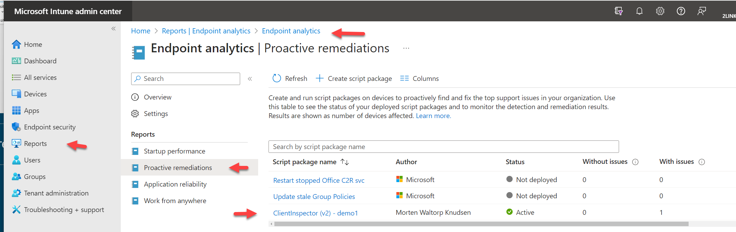
Intune deployment (<200 Kb in size)

Slide 44
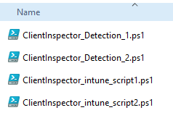
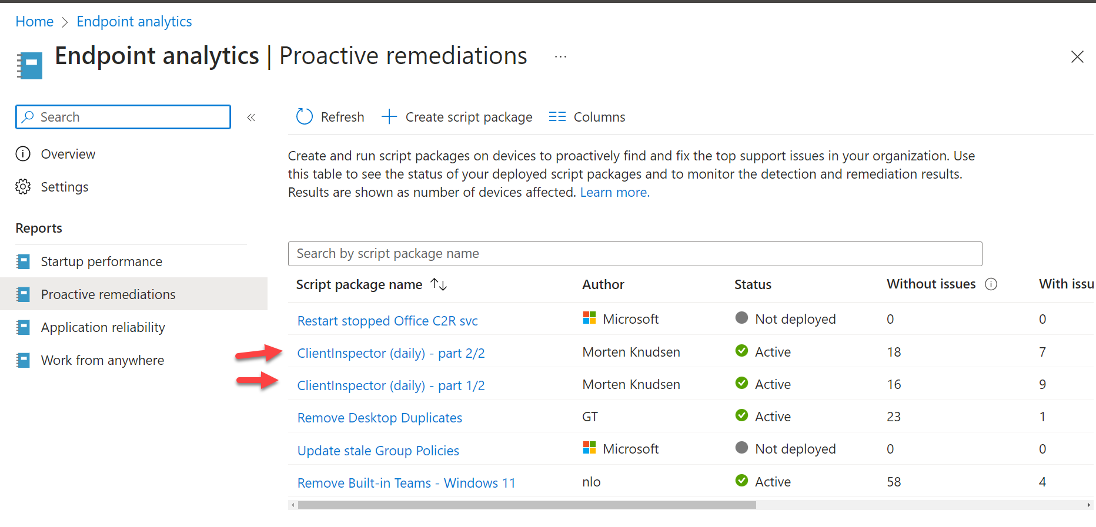
Intune deployment >200 Kb size, split

Slide 45
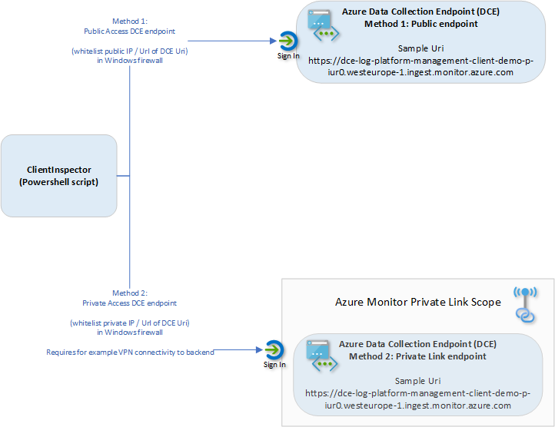
Networking
Client endpoint (REST api)
sends data to DCE

Slide 46
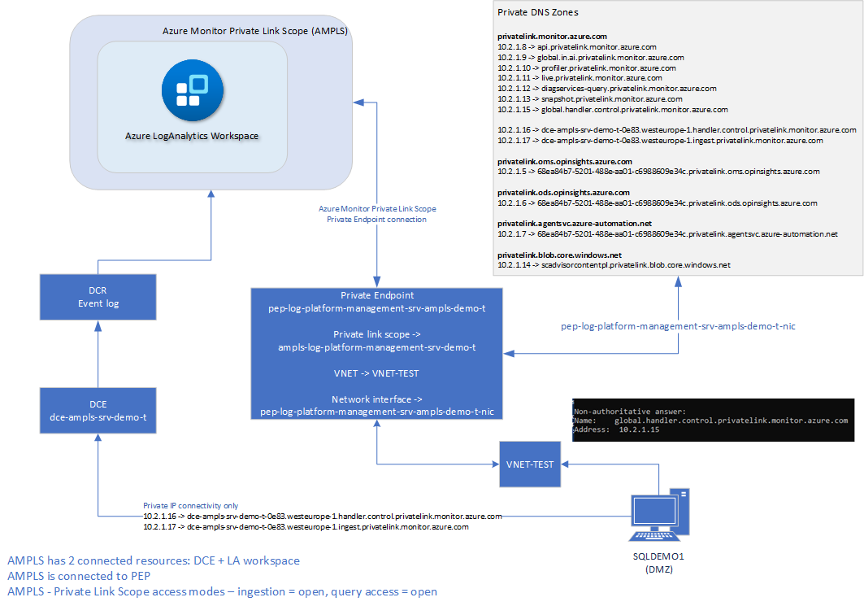

Slide 47
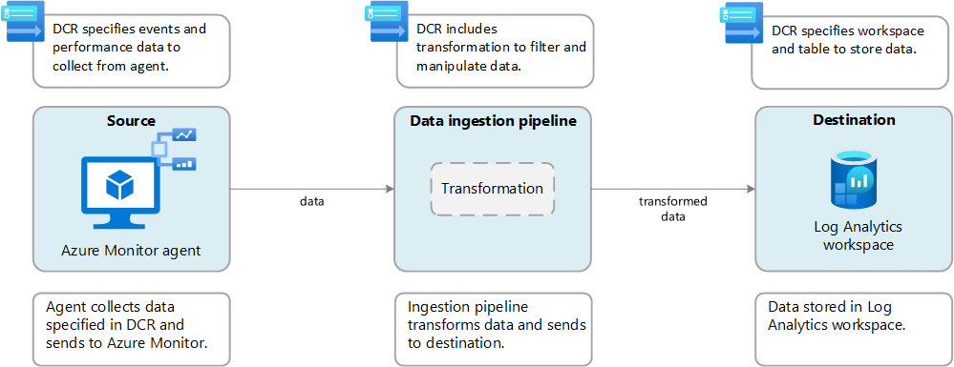
Transformation using AMA & DCR

Slide 48
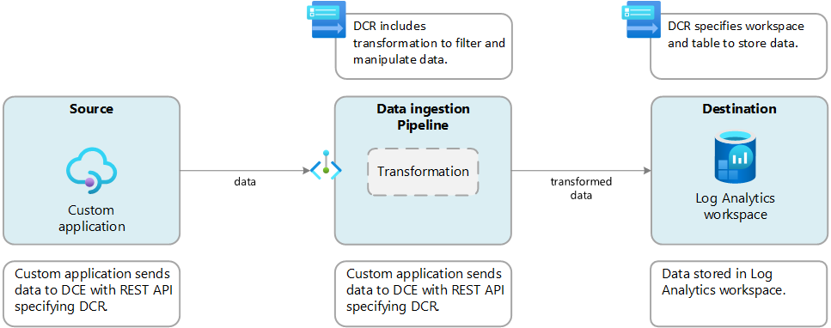
Transformation using Log ingestion API, DCR & DCE

Slide 49
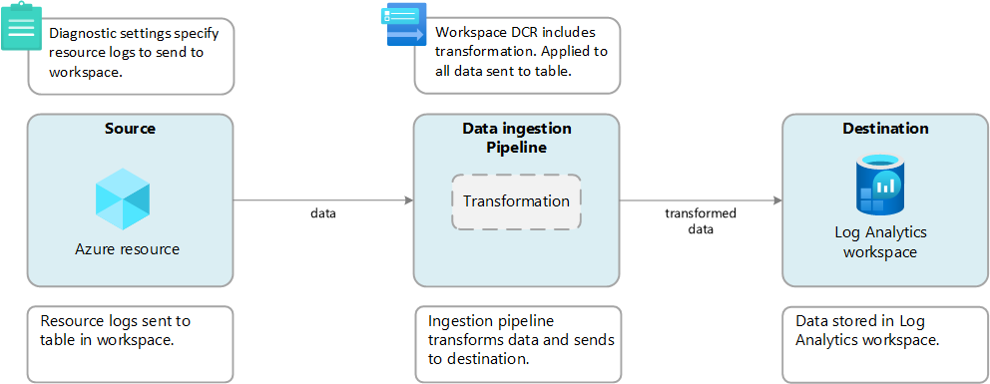
Workspace Transformation DCR

Slide 50
Collection Source | Technologies needed | Resource Association | Target (today)
Performance Eventlog Syslog | AMA / DCR | Required (DCR) | Standard table (LogAnalytics)
Text logs IIS logs Windows Firewall logs (preview) | AMA / DCR / DCE | Required (DCR) | Custom Log table (LogAnalytics)
SNMP traps | Linux with SNMP trap receiver -and- AMA (syslog file) / DCR - or - AMA (syslog stream) / DCR | Required (DCR) | ???? (LogAnalytics)
Change Tracking (legacy | Change Tracking extension (FIM) / DCR | Required (DCR) | Standard table (LogAnalytics)
Custom logs (Log Ingest API) | DCR / DCE | N/A | Custom Log table (LogAnalytics)
Standard logs (Log Ingest API) (*) | DCR / DCE | N/A | Standard table (LogAnalytics)
Standard/Platform Metrics/Telemetry (Azure Paas) | DCR (built-in, non-manageable, hidden) | N/A | Azure Monitor Metrics
Custom Metrics/Telemetry (custom app) | AMA / DCR -or – Azure Diagnostics extension -or- Azure Monitor REST API -or- Linux: InfluxData Telegraf agent (Linux) + Azure Monitor output plugin | Required (DCR) | Azure Monitor Metrics
Platform Logs (diagnostics per resource) AllMetrics (don’t send to LA – you already have data via Azure Monitor Metrics) Resource logs (alllogs, audit) | Azure Policy (Diagnostics) DCR (built-in, non-manageable, hidden) | Required (Policy) | Standard table (LogAnalytics)
Activity logs (audit per subscription) | Azure Policy (Diagnostics) DCR (built-in, non-manageable, hidden) |  | Standard table (LogAnalytics)

Slide 51
Collection Source | Technologies needed | Flow
Performance Eventlog Syslog | AMA / DCR | AMA -> DCR Ingestion Pipeline (backend) → LA
Text logs IIS logs Windows Firewall logs (preview) | AMA / DCR / DCE | AMA -> DCE -> DCR Ingestion Pipeline (backend) → LA
SNMP traps | Linux with SNMP trap receiver -and- AMA (syslog file) / DCR - or - AMA (syslog stream) / DCR | AMA-> DCR Ingestion Pipeline (backend) → LA
Change Tracking (legacy | Change Tracking extension (FIM) / DCR | FIM -> DCR Ingestion Pipeline (backend) → LA
Custom logs (Log Ingest API) | DCR / DCE | REST EndPoint -> DCE -> DCR Ingestion Pipeline (backend) → LA
Standard logs (Log Ingest API) (*) | DCR / DCE | REST EndPoint -> DCE -> DCR Ingestion Pipeline (backend) → LA
Platform (Standard) Metrics/Telemetry (Azure Paas) | DCR (built-in, non-manageable) | Azure Resource -> DCR Ingestion Pipeline (backend) -> Azure Monitor Metrics
Custom Metrics/Telemetry (custom app) | AMA / DCR -or – Azure Diagnostics extension -or- Azure Monitor REST API -or- Linux: InfluxData Telegraf agent (Linux) + Azure Monitor output plugin | AMA -> DCR Ingestion Pipeline (backend) → LA AzDiag Ext -> LA REST EndPoint -> DCE -> DCR Ingestion Pipeline (backend) → LA InfuxData Telegraf -> Azure Monitor output plugin -> LA
Platform Logs (diagnostics per resource) AllMetrics Resource logs (alllogs, audit) | Azure Policy (Diagnostics) DCR | Azure Resource -> DCR -> LA
Activity logs (audit per subscription) | Azure Policy (Diagnostics) DCR | Azure Resource -> DCR -> LA

Slide 52
Server inventory of 114 servers in 2-3 min - using Azure Custom Extension

Slide 53
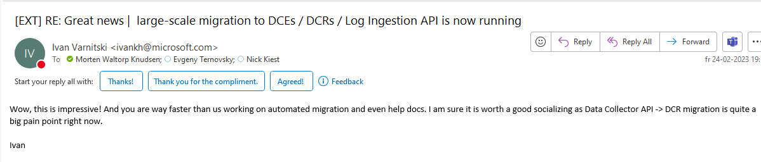



Great teamwork with the product-team

